Slide 1
THE ROLE OF MAGNETIC FIELDS
IN STAR FORMATION
Christopher F. McKee
MFU V Corsica
With: Pak-Shing Li
Oct 7, 2015
Richard Klein
Partial support provided by the National Science Foundation and NASA

Slide 2
OUTLINE
I. Introduction: Magnetic Fields vs. Gravity
II. Observations of magnetic fields in molecular cloud cores:
(1) Small Scales (~< 1 pc) (Crutcher et al. 2010)
(2) New Results from Old Data (Li, McKee & Klein 2015—LMK)
III. Observing interstellar magnetic fields on a computer (LMK)
IV. Magnetic Fields vs. Turbulence: The mean interstellar field is not weak-- M_{A} ~ 1
V. Conclusions

Slide 3
I. Introduction: Magnetic Fields vs. Gravity
Magnetic energy scales as gravitational energy, so there is a magnetic critical mass:
independent of scale
where Φ = πR²B is the magnetic flux
Magnetic energy = gravitational energy at the magnetic critical mass:
(Numerical coefficient gives condition for instability for a magnetized sheet)
Normalized mass-to-flux ratio:
Magnetically supercritical: E_{G} > E_{B} , μ_{Φ} > 1 => Cloud can collapse
Magnetically subcritical: E_{G} < E_{B ,} μ_{Φ} < 1 => Cloud cannot collapse
In ideal MHD, mass-to-flux ratio can increase only due to mass flow along the magnetic field; mass transport across the field is impossible
Notes:
Mestel and Spitzer referred to starlight polzn and Fermi’s theroy of CR accel as justif for B

Slide 4
The Magnetic Flux Problem
The diffuse ISM is magnetically subcritical=>cannot form stars (Mestel & Spitzer 56)
1. Magnetic fields exceed gravity in atomic ISM
Modern 21 cm observations => μ_{Φ} < 1/6 in HI (Heiles & Troland 2005)
2. The length scale required for flow along the field to change this is too large to be effective in forming stars
Their argument with modern data:
Let N = nL = column density along the field
size of 1 M_{sun} cloud for μ_{Φ} > 1
(In fact, this is the length scale for formation of Giant Molecular Clouds, which were not discovered until 20 years later)

Slide 5
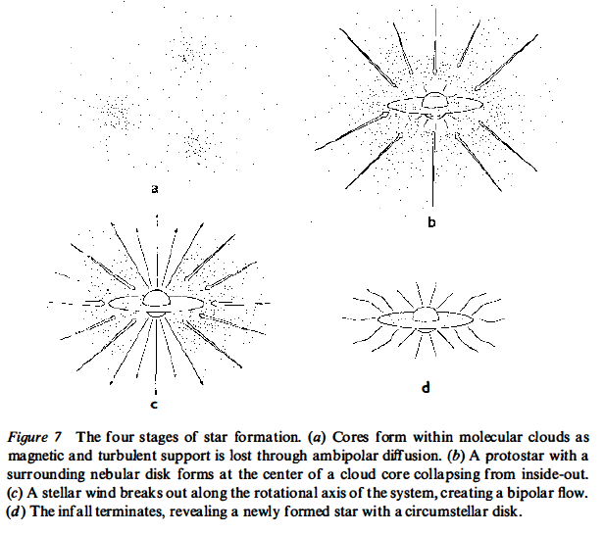
Classical Solution: Ambipolar Diffusion
Mestel & Spitzer: since impossible to gather enough gas along the field to overcome the magnetic field, neutrals must undergo gravitational contraction by slipping through the ions and the magnetic field in shielded regions---ambipolar diffusion
This became the standard paradigm for low mass star formation:
Ambipolar diffusion enables gas to evolve from magnetically subcritical (μ_{Φ} < 1) to magnetically supercritical (μ_{Φ} > 1) (Shu+ 87)
(Shu, Adams & Lizano ARAA 1987)

Slide 6
II. Observations of Magnetic Fields in Molecular Clouds:
(1) Small Scales (Crutcher et al 2010)
Zeeman observations of N B_{los} = column density x density-weighted line-of-sight (los) field in HI, OH and CN
Let B_{tot} = magnitude of the density-weighted total magnetic field from Zeeman observation, before projection along the los
Then, since median cos theta=0.5, median B_{tot} = 2 x median B_{los}
Recall that the atomic ISM is magnetically subcritical
However, molecular cloud cores are magnetically supercritical
Theory: GMCs have μΦ ~ 2 (McKee 1989)
Crutcher (1999): Cores typically have μΦ = 2πG^{1/2} (M/Φ) > 1
Alfven Mach number M_{A} ~ 1
Troland & Crutcher (2008): OH observations with Arecibo
Cores magnetically supercritical: median μΦ = 1.7-2.6
Median M_{A} =1.5

Slide 7
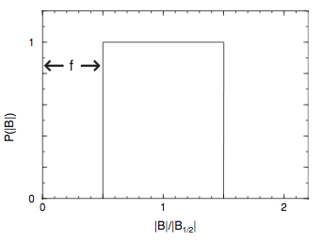
Analysis of Zeeman observations suggests uniform distribution of B_{tot}
(Crutcher+ 2010)
Use Bayesian analysis to include the majority of points with only upper limits on B_{los}
Results:
For n_{H} > 300 cm⁻³ (ie., excluding most HI data), B_{tot} varies as n_{H} ^{α} with α ≈ 0.65
Note: this describes B_{tot} for a clump as a function of its average density, not the variation of B within an individual clump.
B_{tot}/n_{H}^{0.65} uniformly distributed from f B_{max}/n_{H}^{0.65} to B_{max}/n_{H}^{0.65} with f ≈ 0.03
Much better fit than delta function distribution for B_{tot}/n_{H}^{0.65}
Implies significant fraction of volume of ISM has low magnetic field

Slide 8
II. Observations of Magnetic Fields in Molecular Clouds:
(2) New Results from Crutcher et al. Data (LMK)
Analyze measured line-of-sight (los) fields instead of inferred total fields
Numerical experiment confirms that must treat all data equally, including data < 2 sigma (41 of 68 observed cores)
Density scaling: B_{los} varies as density^{α}, with α = 0.63 ± 0.07
Confirms Crutcher et al result that α(B_{tot}) = 0.65
Magnitude of B_{los}: <B_{los}> (n) ≈ 21 n₄^{0.65} μG adopting Crutcher α
Since <B_{tot}> = 2 <B_{los}>, it follows that the average field in molecular clumps in the ISM is
<B_{tot}> ≈ 43 n₄^{0.65} μG

Slide 9
III. Observing Interstellar Magnetic Fields on a Computer
(P-S Li, CFM, & R. Klein--LMK)
Observations:
Zeeman observations give the density-weighted line-of-sight component of the field,
Polarization gives direction of B in plane of sky
Davis-Chandrasekhar-Fermi method: estimate magnitude of B_{pos} from fluctuations in direction and measurement of turbulent velocities
Numerical simulations give full 3D field

Slide 10
Differences between simulation and observations:
Observations sample clouds with a range of physical conditions; simulation has a single set of initial conditions
Observations smoothed over scale depending on distance to source; simulations smoothed on 0.03 pc scale
Maximum mass in simulation is 74 M_{sun} vs 1400 M_{sun} (OH) and 1700 M_{sun} (CN)
Simulations do not include non-ideal effects like ambipolar diffusion

Slide 11
High-Resolution Turbulent Box Simulation
Code: ORION2 ideal MHD with adaptive mesh refinement (AMR)
(P-S Li + 12)
Simulation:
Physics included in simulation: Ideal MHD, self-gravity
Periodic boundary conditions
Drive turbulence at large scales (k=1-2) throughout simulation
Turn on gravity after 1 free-fall time, when turbulent density field established
Resolution: 512³ base grid with 2 levels of refinement (max. resolution 2048³)
Dimensionless parameters:
Mach numbers: Sonic M = 10, Alfven M_{A} = 1
Gravitational energy ~ turbulent energy: α_{vir} = 5σ²L/(2GM) = 1
Magnetically supercritical: μ_{Φ} = (5π/6α_{vir})^{1/2} M_{A} = 1.62
Notes:
Collins+ 11 had 128^3 and 4 levels of refinement for max of 2048^3, like us. Assumed weak initial B

Slide 12
Setting the Scale
Isothermal MHD simulations are scale free: mass, length, time arbitrary
With self-gravity, one dimensional relation set by G:
α_{vir} = 5σ²L / (2GM) = 1
Second dimensional relation set by k_{B} T :
Assume T = 10 K, the typical temperature in molecular gas
Final dimensional relation set by assuming that the turbulence obeys the relation between the line width and size observed in molecular clouds:
Set v_{rms} = 0.85 L_{pc}^{0.5} km s⁻¹ in the simulation box
=> M = 3100 M_{sun} , L = 4.55 pc, n = 960 cm⁻³ , B = 32 μG, Δx = 500 AU

Slide 13
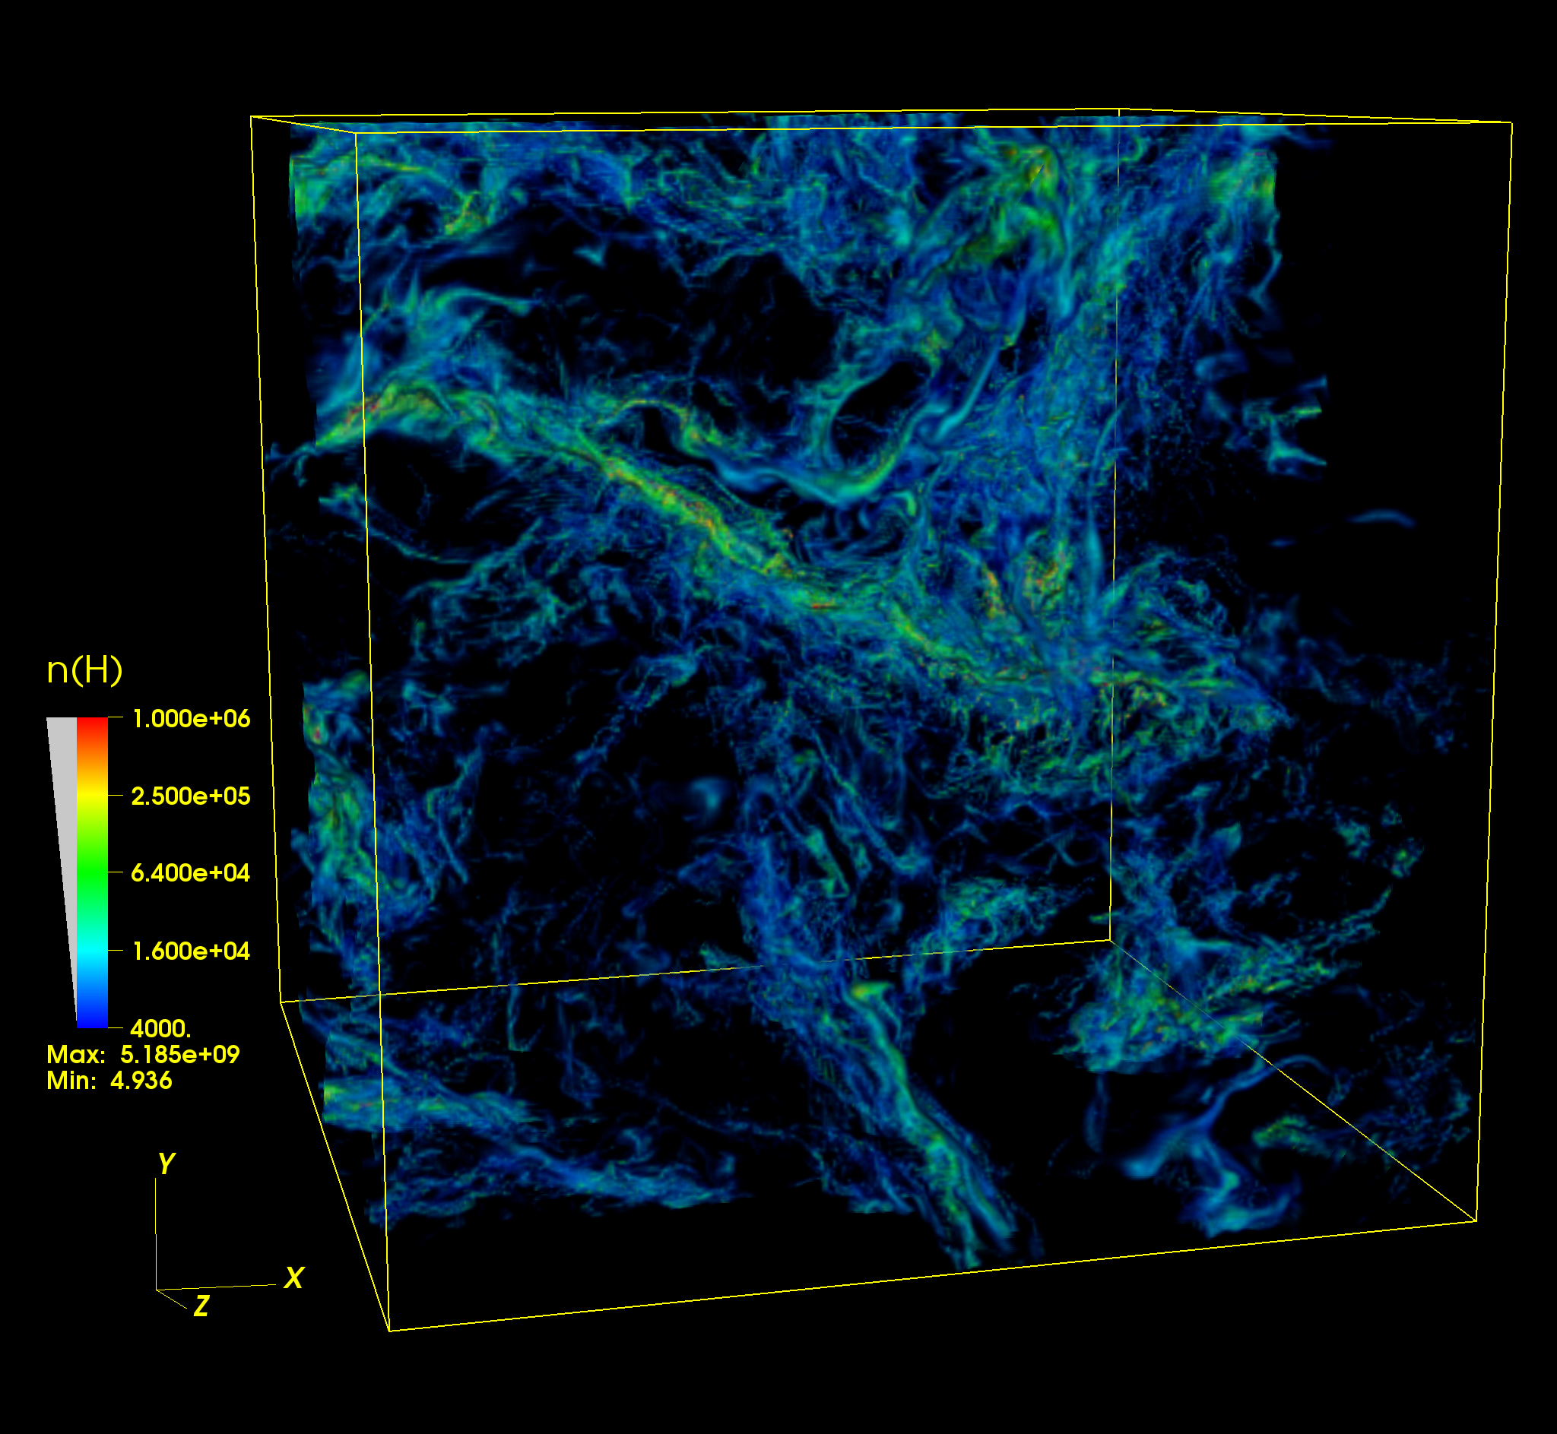
Volume Rendering of Density in the Magnetized Turbulent Box
t=0.5 t_{ff} after gravity on
Mean density: 960 cm⁻³
Half mass above 5300 cm⁻³
← 4.55 pc →

Slide 14
Sample of Molecular Cloud Cores from Simulation
At t=0.57 free-fall times (t = 8x10⁵ yr) after gravity turned on
16% of mass has density high enough to have formed stars
Find cores with Clumpfind (Williams + 1994)
Merge all cores separated by < 0.06 pc, the smallest separation permitted in the observations
Choose the 100 most massive cores (minimum M is 1.2 M_{sun})
For comparison with observation, consider a central beam with radius 0.3 r, the median value for observed clouds
These regions are well resolved, with > 10⁴ cells, median 47000 cells
Notes:
Delta rho/rho = 0.01; use fine level, not just base grid
Use threshold density equal to the density-weighted median <n>_{M} = 5300 cm⁻³ (i.e., half the mass is above this density)

Slide 15
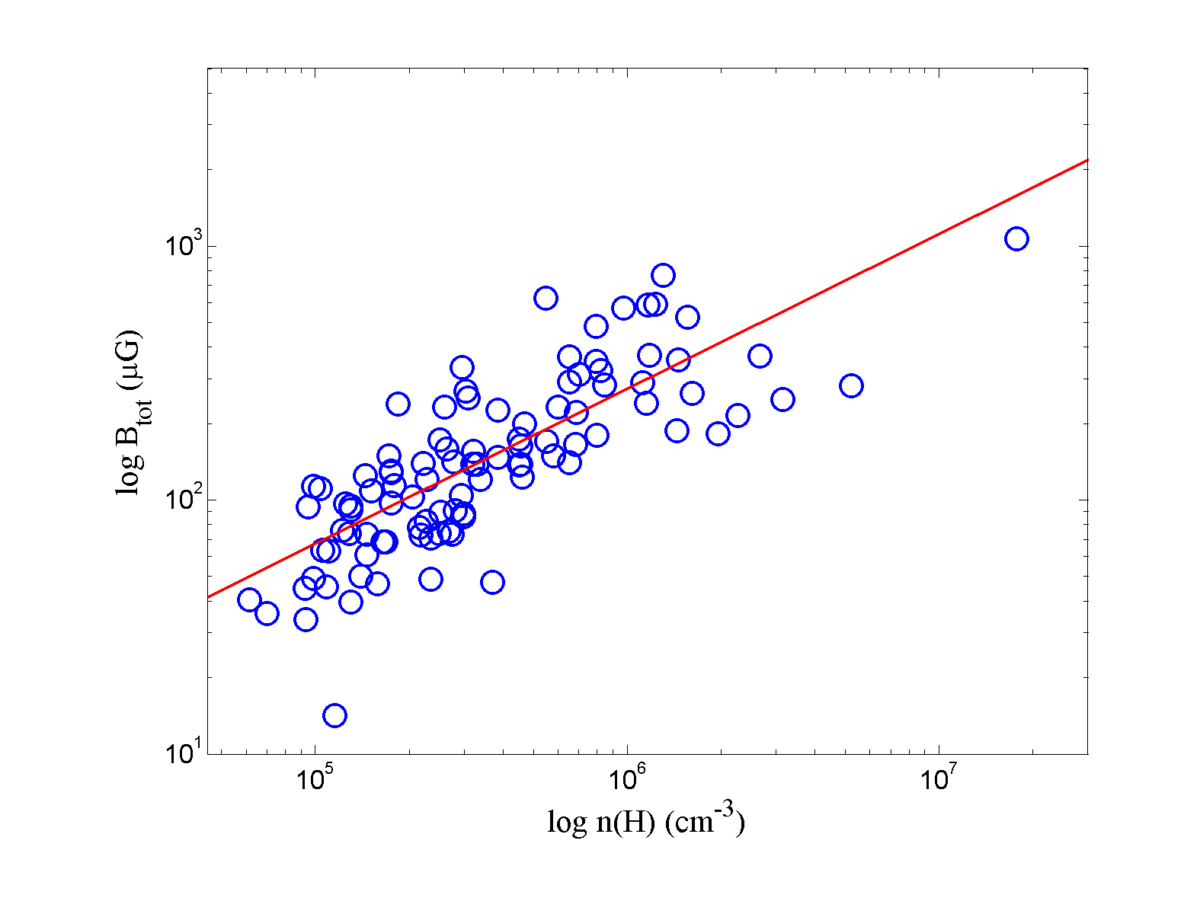
Density Scaling of Magnetic Field: Agrees with Observation
Crutcher + (2010) infer B_{tot} varies as n^{α} with α = 0.65
For the 68 OH+CN molecular cores: median, (B_{los} / n₄^{0.65})_{1/2} = 11.9
100-core sample:
Time-averaged <α> = 0.70 ± 0.06
<B_{tot} /n₄^{0.65}>_{1/2} = 18.7
<B_{los} / n₄^{0.65}>_{1/2} = 8.9
Median B_{tot} ≈ 2 B_{los} ✓ Simulated B_{los} / n^{0.65} ≈ 0.75 x observed

Slide 16
Density Scaling of Magnetic Field: Agrees with Observation
Crutcher + (2010) infer B_{tot} varies as n^{α} with α = 0.65
For the 68 OH+CN molecular cores: median, (B_{los} / n₄^{0.65})_{1/2} = 11.9
100-core sample:
Time-averaged <α> = 0.70 ± 0.06
<B_{tot} /n₄^{0.65}>_{1/2} = 18.7
<B_{los} / n₄^{0.65}>_{1/2} = 8.9
Scaling due to self-gravity: not present before gravity turned on.

Slide 17
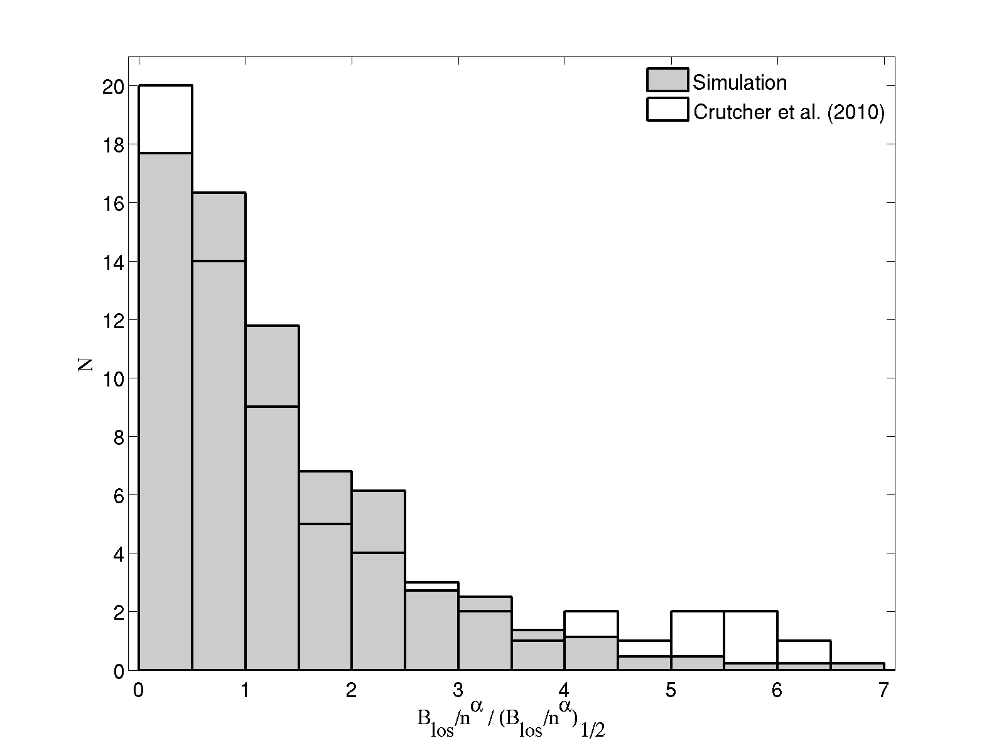
Distribution of Line-of-Sight (LOS) Field Agrees with Observation
The K-S test shows that the simulation is similar to the data (p=0.50)
Remarkable, since data drawn from many clouds with different conditions

Slide 18
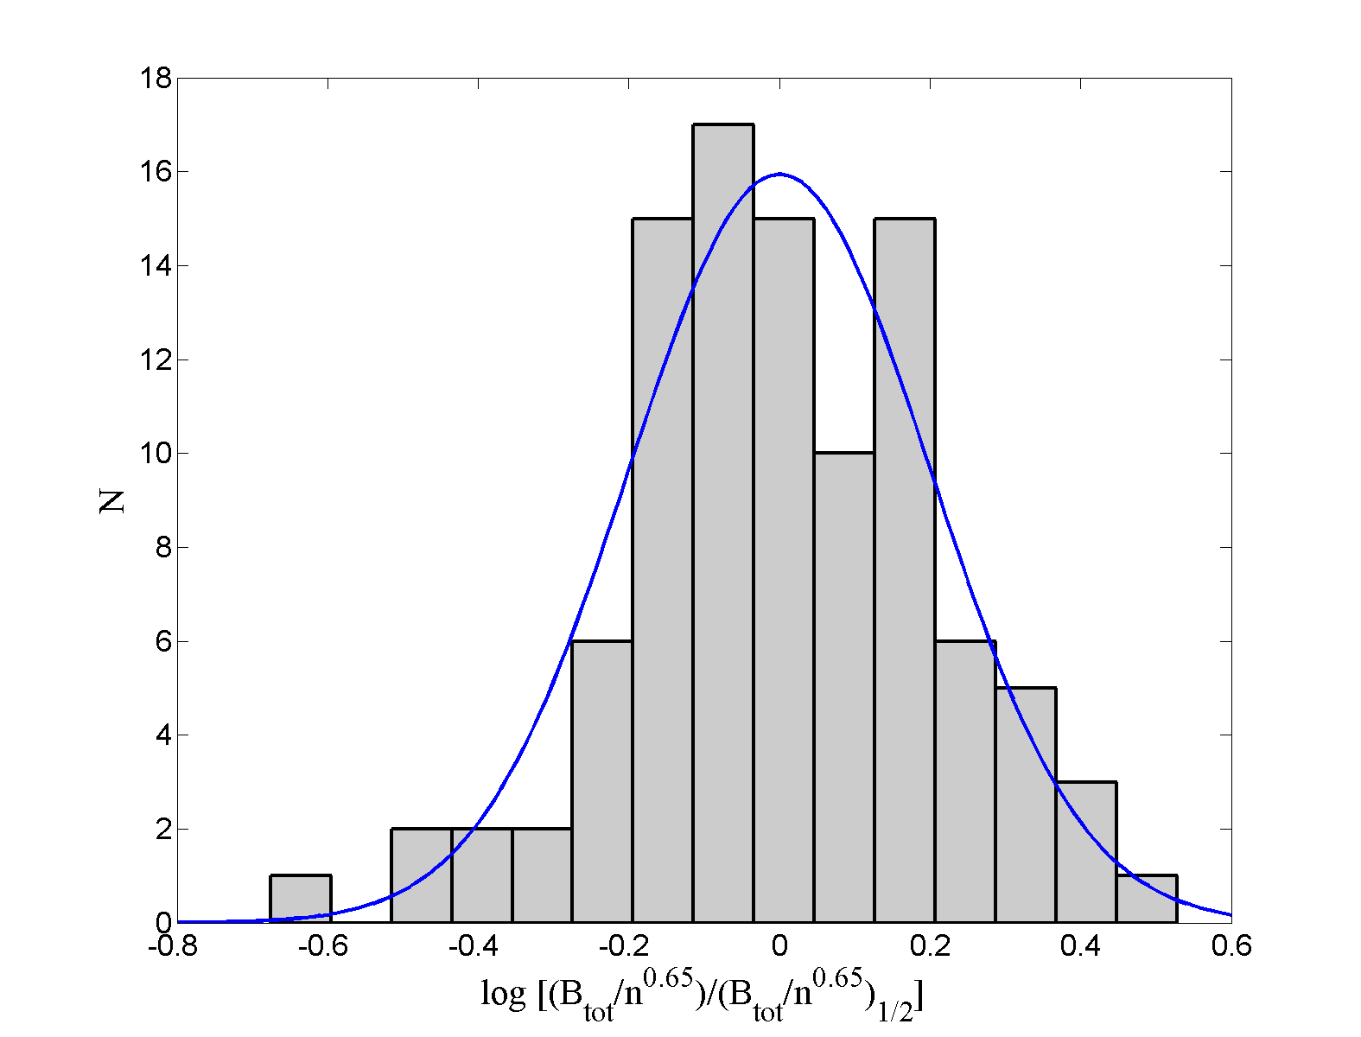
Log-Normal Fit for the Distribution of Simulated B_{tot}
Not a uniform distribution as inferred by Crutcher et al
The dispersion of the log-normal is 0.2, corresponding to a factor 1.66
The K-S test for goodness of fit gives p=0.89

Slide 19
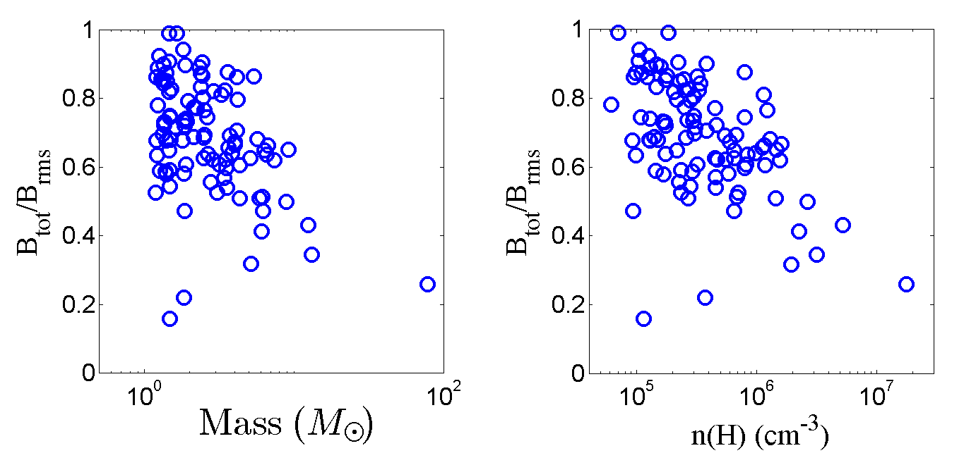
Field-line tangling prevents very low B_{rms} , particularly in more massive
and/or denser cores
In 100-core sample, very small fields inferred from Zeeman obs. are due to tangling along los
Smallest B_{rms} / n^{0.65} = 1.1 (B_{los} / n^{0.65})_{1/2}
Smallest B_{tot} / n^{0.65} = 0.69 (B_{los} / n^{0.65})_{1/2} , ~ 3 times value in Crutcher+ model

Slide 20
The Mass-to-Flux Ratio μ_{Φ} in Simulated Clumps--1
Observers measure μ_{Φ,los}, which varies as Σ_{los}/B_{los}, in central beam
Measuring μ_{Φ} in turbulent clumps in simulations:
Define disk with size of telescope beam centered on densest point
Define μ_{Φ} as the minimum value over all orientations
For constant density clump, corresponds to B perpendicular to disk
For constant density clump:
Spherical: B_{med} = 2 B_{los,} _{med} => μ_{Φ,actual} = 0.5 μ_{Φ,los,med}
Sheet: Σ_{perp,med} = (1/2) Σ_{obs,med} => μ_{Φ,actual} = 0.25 μ_{Φ,los,med}
Hence actual μ_{Φ} is (0.25-0.5) times the observed one for constant-density
clouds that are spherical or gravitationally flattened along B

Slide 21
The Mass-to-Flux Ratio μ_{Φ} in Simulated Clumps--2
Recall actual μ_{Φ} is (0.25-0.5) times the observed one for constant-density
clouds that are spherical or gravitationally flattened along B
But real clouds and simulated clouds do not have constant density
Key point: Observed μ_{Φ,los} depends on mass-weighted B
Actual (theoretical) μ_{Φ} depends on area-weighted B
We find actual median μ_{Φ} is 0.7 x observable median los μ_{Φ}
(significantly larger than (0.25-0.5) x observable median los μ_{Φ} )
For Crutcher ea (2010) sample, median los μ_{Φ} = 4 => actual μ_{Φ} = 3
Observed molecular clumps are significantly magnetically supercritical

Slide 22
Conclusions from Simulation of Magnetized Molecular Cloud
*Excellent agreement with density dependence of B_{tot}:
<α> = 0.70 (sim) vs. 0.65 (obs)
*Very good agreement with observed distribution of B_{los} / n^{0.65}
Median values differ by only a factor 1.3
*Median simulated μΦ (B_{los}) is 2.7 (sim), observed is 4.1 (Crutcher ea 10)
*Actual μΦ ~ 3 in observed molecular cores: significantly magnetically supercritical
=> No evidence that ambipolar diffusion important in the Crutcher et al sample of observed cores

Slide 23
Increase in mass-to-flux ratio beyond ideal MHD limit--1
Flux freezing implies that μΦ can decrease as matter fragments along a flux tube, but it can never increase on a flux tube.
We find that 55% of the cores have μΦ(B_{tot}) > initial value for the entire box (1.62), with a maximum of μΦ = 13 (measured in central 0.3 r).
Two possibilities:
Numerical diffusion—but we verified convergence to 0.37 t_{ff}
(Could not afford high resolution run to end of simulation at 0.64 t_{ff} )
Turbulent reconnection, leading to “reconnection diffusion” (Lazarian 05; Santos-Lima+10; Lazarian+12)

Slide 24
Increase in mass-to-flux ratio beyond ideal MHD limit--2
Turbulent reconnection:
In a turbulent medium, fluctuations in the magnetic field cascade down to small scales (Goldreich & Sridhar 1995), permitting reconnection throughout the volume of the turbulent medium (Lazarian & Vishniac 1999)
Since reconnection diffusion is based on a turbulent cascade, the mechanism for resistivity is not crucial, so it is automatically included in numerical simulations, which have numerical resistivity.
Our results support, but do not prove, turbulent reconnection as the origin of the supercritical (weak) fields in molecular clouds
Ideal MHD is not ideal in a turbulent medium

Slide 25
IV. THE MEAN INTERSTELLAR FIELD IS MODERATELY STRONG: M_{A} ~ 1
Relative strength of magnetic field and turbulence measured by
Alfven Mach number M_{A} = v_{rms} / v_{A} = ( 4π<ρv²> / B² )^{1/2}
Let M_{A} be the value for the mean magnetic field
Strong mean field: M_{A} ~< 1: uniform field >~ random field
Weak mean field: M_{A} >> 1: field strongly tangled (Padoan et al.)
Observations (H.-B. Li et al 2009): Compare
(1) Zeeman observations of clumps on scales ~ < few pc with
(2) Polarization observations of GMCs on scales of 100-200 pc

Slide 26
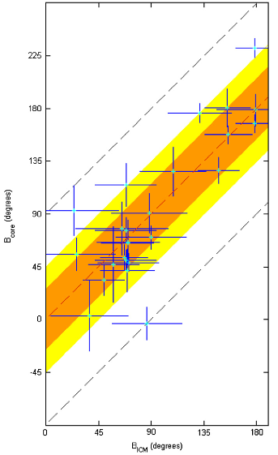
Magnetic field structure on 200 pc scale in diffuse ISM correlated with that on < 1 pc scale in molecular clouds --- (Hua-Bai Li + 2009)
Orientation of field in molecular cloud cores determined via submillimeter polarimetry (0.1-0.3 pc)
90% of cores have B within 45 degrees of that in ambient medium => turbulence does not dominate the field (M_{A} ~< 1)
Cores may be magnetically supercritical, but not too much unless turbulence very weak compared to gravity (α_{vir} <<1)
(recall μ_{Φ} = (5π/6α_{vir})^{1/2} M_{A} )
Orientation of field in surrounding intercloud medium on 200 pc scales determined by optical polarization

Slide 27
Two simulations:
“Strong” field: M_{A} (<B>) = M_{A} (B_{initial}) = 1
Weak field: M_{A} (<B>) = M_{A} (B_{initial}) = 10
Turbulence amplifies weak field so that M_{A} drops to 1.86;
in strong field case, M_{A} drops by only 15%
Local properties of weak-field simulation consistent with observation and strong field model:
B varies as n^{0.57} consistent with observed n^{0.65}
Means and medians of B_{los}/n^{0.65} and B_{tot}/n^{0.65} agree with strong field results within 25%, even though initial field 10 x weaker

Slide 28
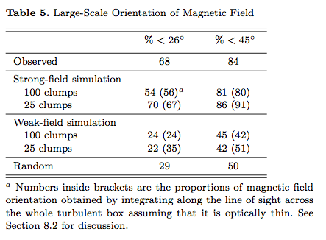
Orientation of core fields with mean field in simulations
Strong field orientations consistent with observation, weak field random
(LMK)
Conclude: Obs. and simulation => GMCs have moderately strong mean fields
(simulated field is nonetheless supercritical)

Slide 29
CONCLUSIONS
Analysis of line of sight fields and simulations confirms Crutcher et al’s conclusion that B varies as n^{α} with α ≈ 0.65
=> B ≈ 43 n₄^{0.65} μG in molecular cloud cores
Scaling due to self-gravity
Actual (area-weighted) mass to flux ratio ≈ 0.7 x observed (mass-weighted, los) mass to flux ratio: Observed actual value ≈ 3
No evidence for ambipolar diffusion in this sample
Mass to flux ratio in converged simulations increased above initial value for entire simulation box, consistent with turbulent reconnection:
Ideal MHD is not ideal in a turbulent medium
Simulations confirm Hua-Bai Li et al’s results that the mean magnetic field in GMCs is moderately strong in that M_{A} ~ 1 for the mean field

