Slide 1
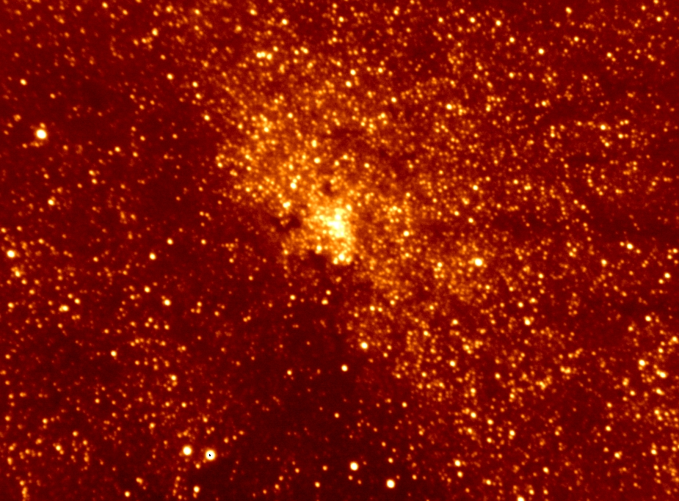
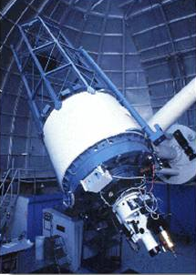
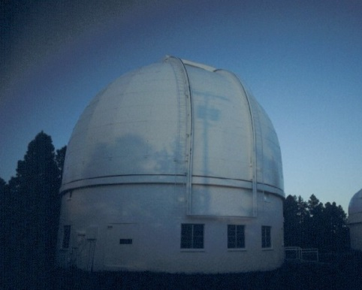
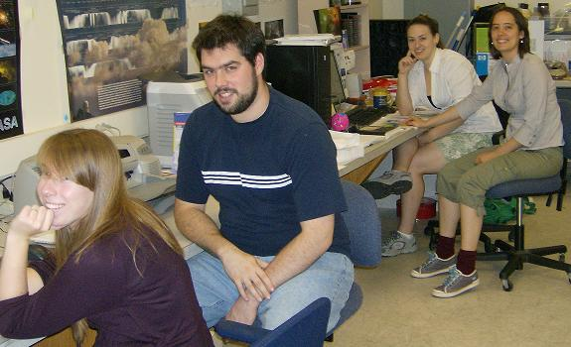
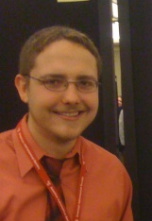


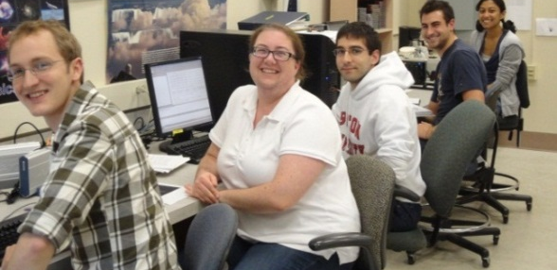

The Magnetic Field in the Cool Interstellar Medium: First Results from the Galactic Plane Infrared Polarization Survey (GPIPS)
Dan Clemens, Ren Cashman, Sadia Hoq, and Jordan Montgomery
[Boston University]
With lots of help from:
Julie Moreau (UG), Mike Pavel (G), Katie Jameson (UG), April Pinnick (G), Rob Marchwinski (UG)
Jordan Montgomery (G), Ren Cashman (G) , Pantelis Thomadis (UG), Ian Santagata (UG), & Sadia Hoq (G)
Gen I
Gen II
Grants NSF/MPS/AST
06-07500,
09-07790, &
14-12269

Slide 2
Key Questions
In the Galactic disk, do magnetic fields have important roles in the formation and evolution of atomic and molecular clouds?
Within molecular clouds, do magnetic fields have important roles in the formation and evolution of dense cloud cores?
Within dense cloud cores, do magnetic fields have important roles in star formation?

Slide 3
We have been Data-Starved: Needed a Large Survey
Galactic Plane Infrared Polarization Survey (GPIPS)
  Specialized NIR instrumentation = Mimir (+ Perkins 1.8m telescope + hundreds of nights)
  GPIPS observations, data processing, public data release
Early Magnetic Field Science with GPIPS & Mimir
Great Science in Progress
  Infrared Dark Clouds and star formation – poster, PhD work by Sadia Hoq
  100-Molecular Cloud sample & role of B-fields – poster, PhD work by Ren Cashman
  Polarization of Edge-on Galaxies Sample (PEGS) – poster, PhD work by Jordan Montgomery
Over 1 million high-quality background starlight near-infrared (NIR) linear polarizations

Slide 4
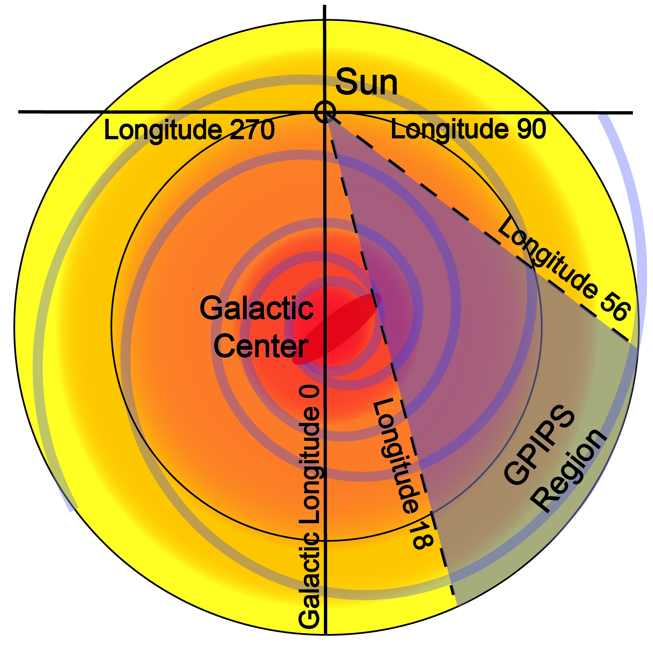
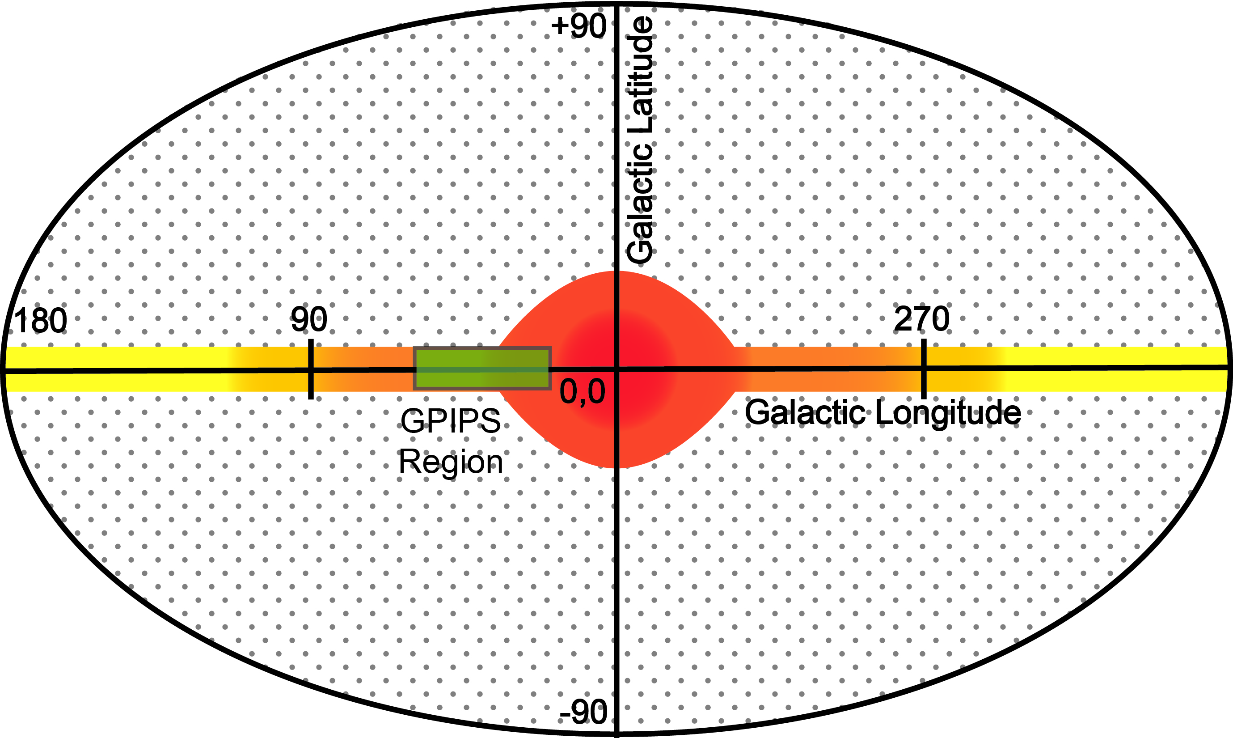
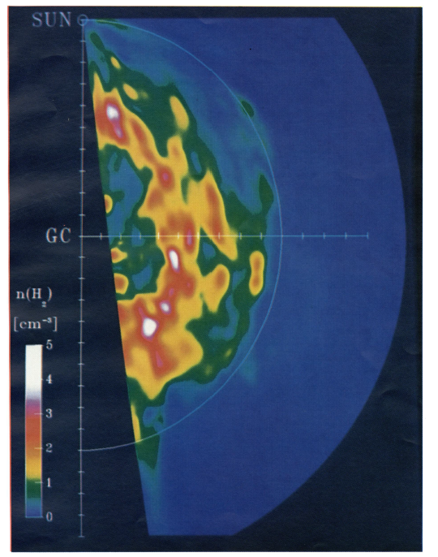
Where to look?
Face-on Cartoon – want to probe the zone in the inner galaxy most involved in star formation (& visible from Northern hemisphere)
Edge-on Cartoon – want to probe in the disk plane mostly, also +/- some
Clemens+88

Slide 5
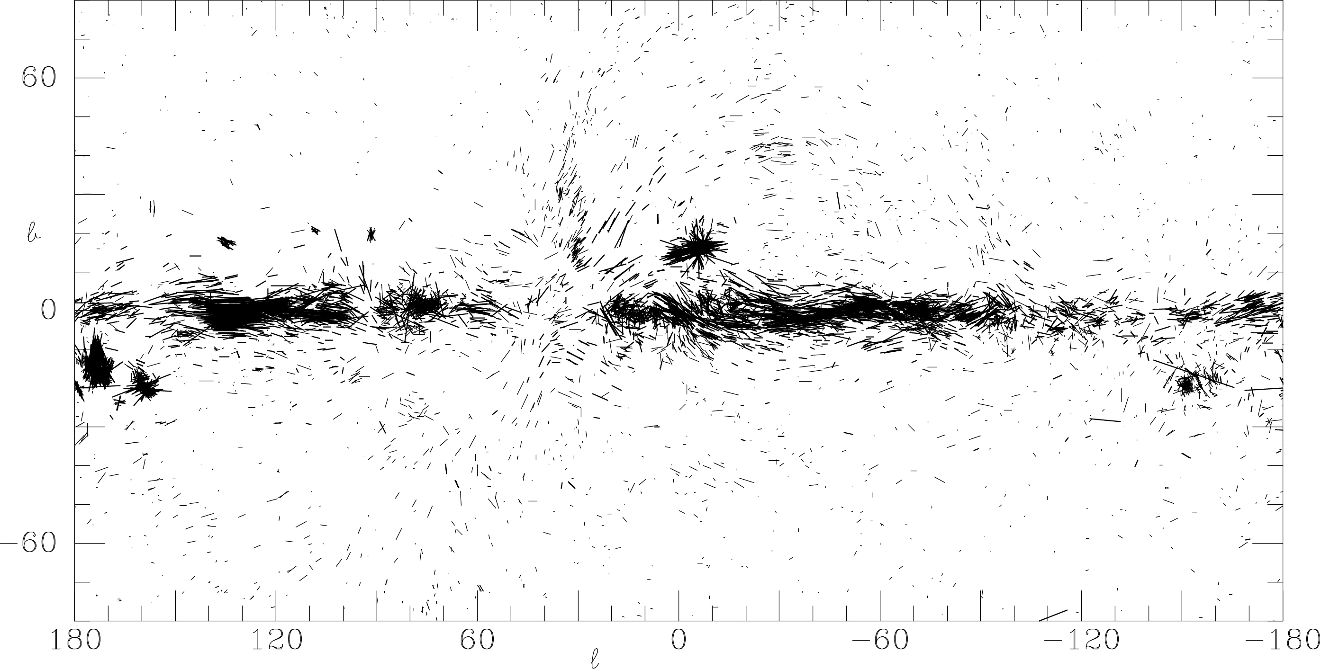
Galactic B via Background Starlight Polarization Mapping: Optical λ Summary
GPIPS Survey Region
Next Slide
Data from Mathewson & Ford (1970) plus Klare & Neckel (1977), compiled by Heiles (2000)

Slide 6
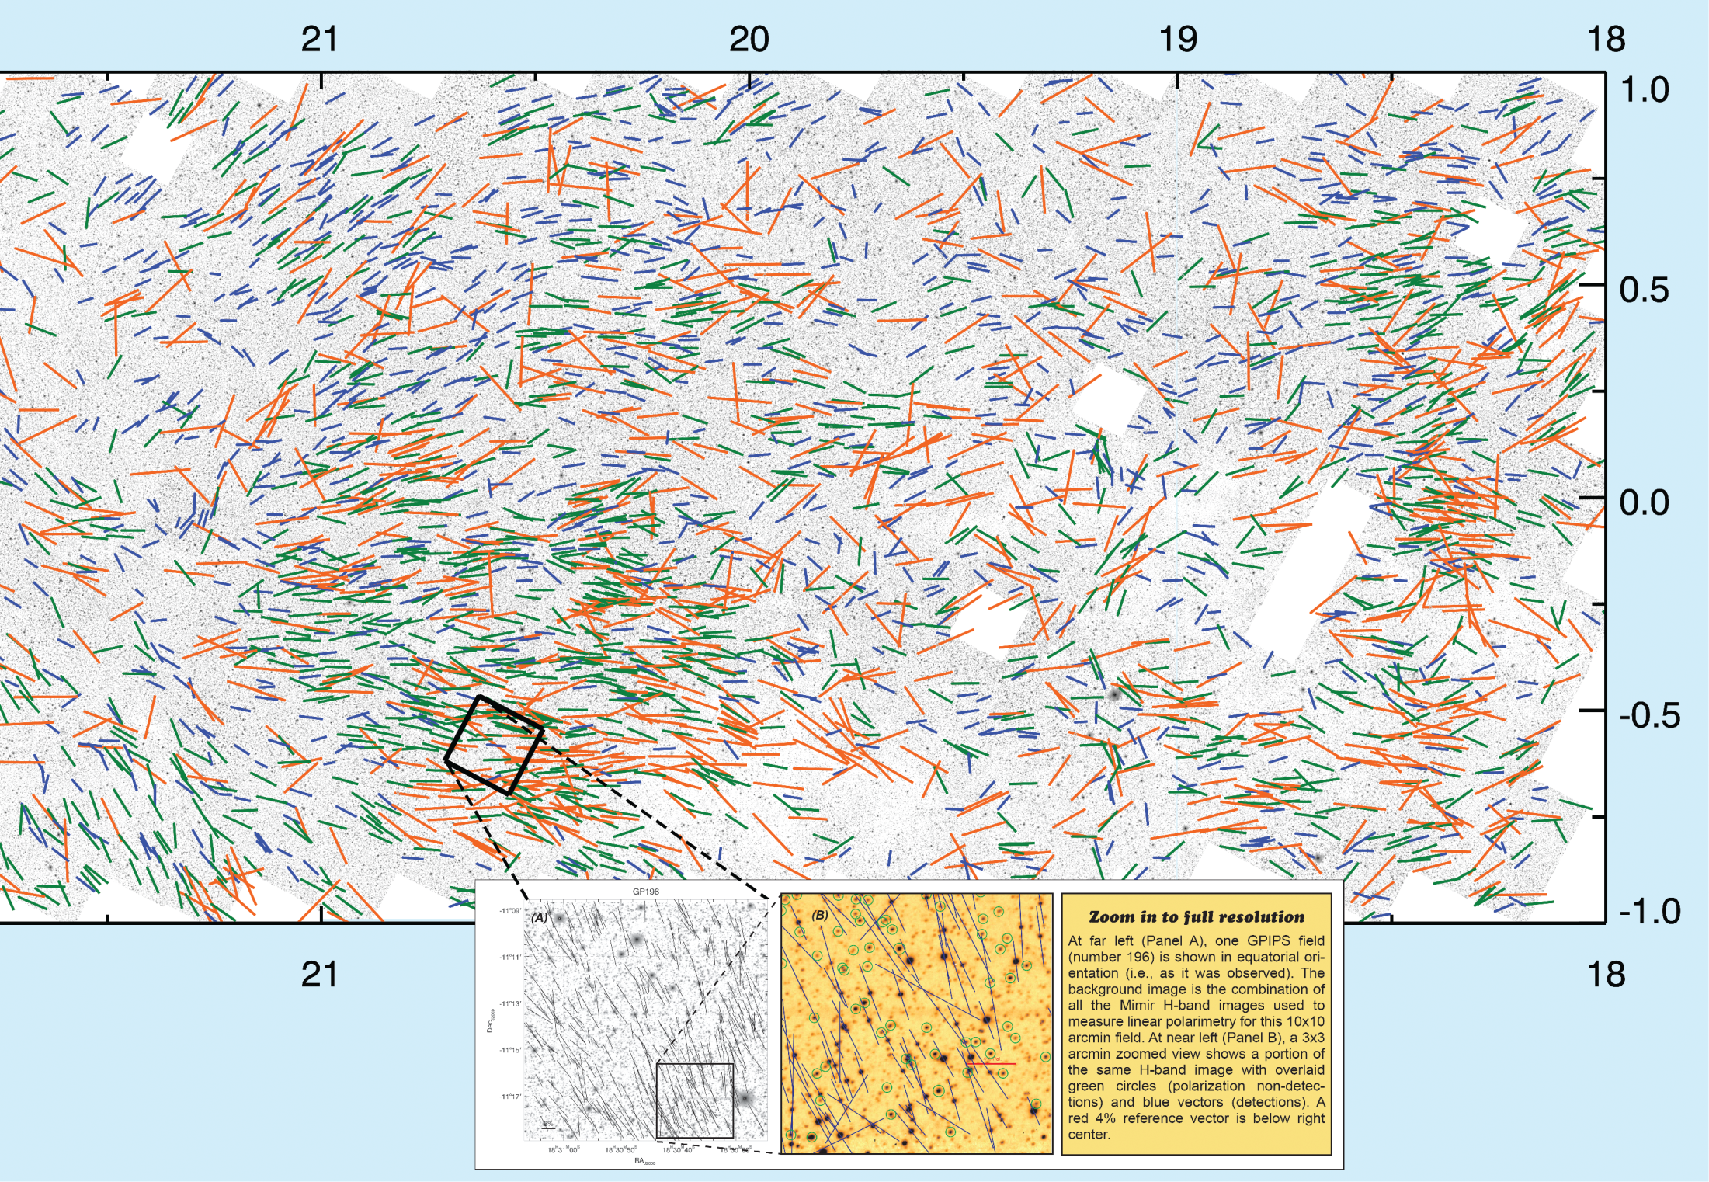
Zoom 3.5 x 2.0 deg; B-field Plane-of-Sky orientations
Vector colors relate to Pol%

Slide 7
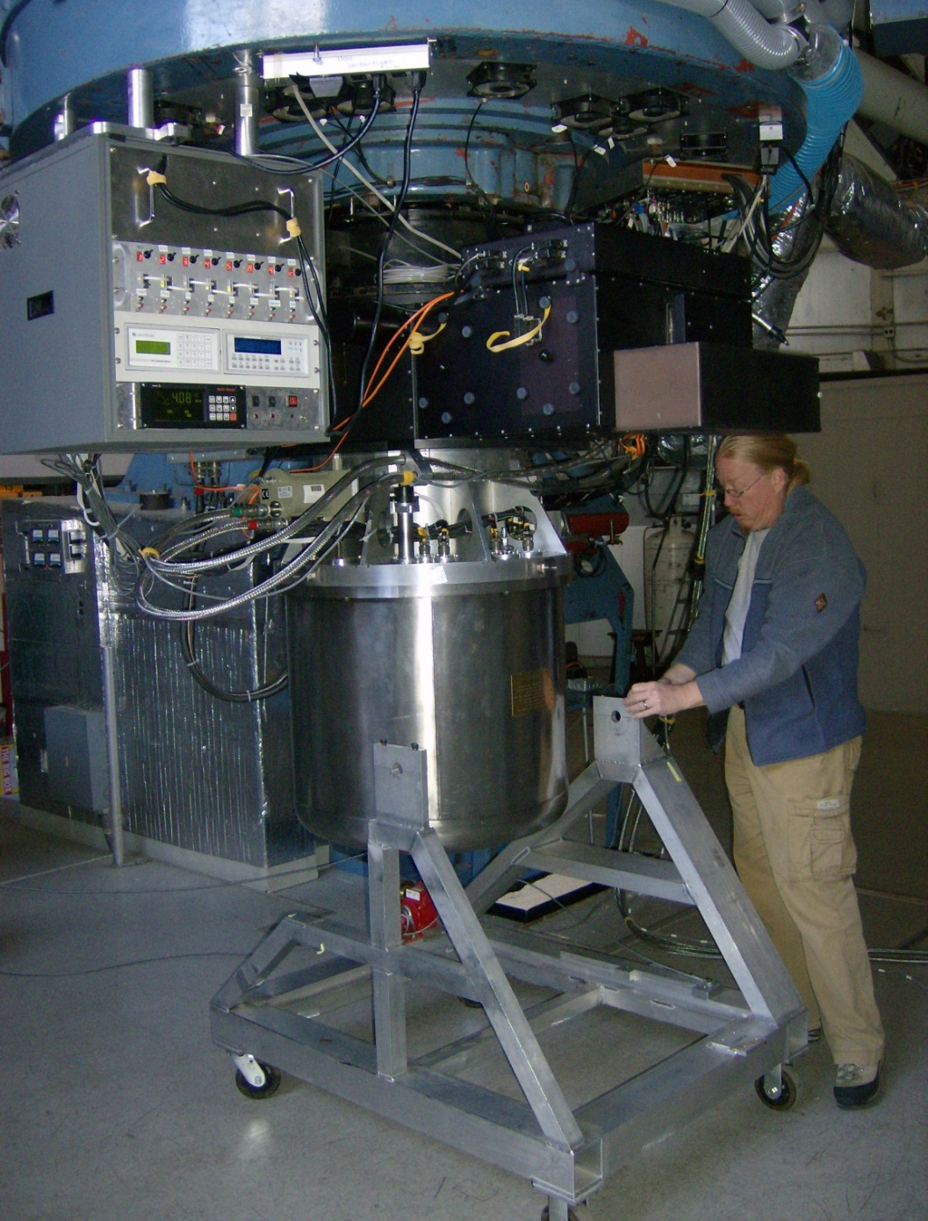
Mimir = Near-IR “Swiss Army Knife” (Clemens+07)
NIR 0.9 - 5.5 μm Wavelengths
1024 x 1024 pixel InSb ALADDIN III detector array
Wide field of view (10x10’) @ 0.58” per pixel
J, H, Ks imaging, linear polarimetry (H, Ks), low-R spectroscopy
L, M spectroscopy, imaging
Good image quality - 0.9 - 2” FWHM on 1.8m Perkins
Data Collection robust, efficient
Scripted operation for complex polarimetry mapping

Slide 8
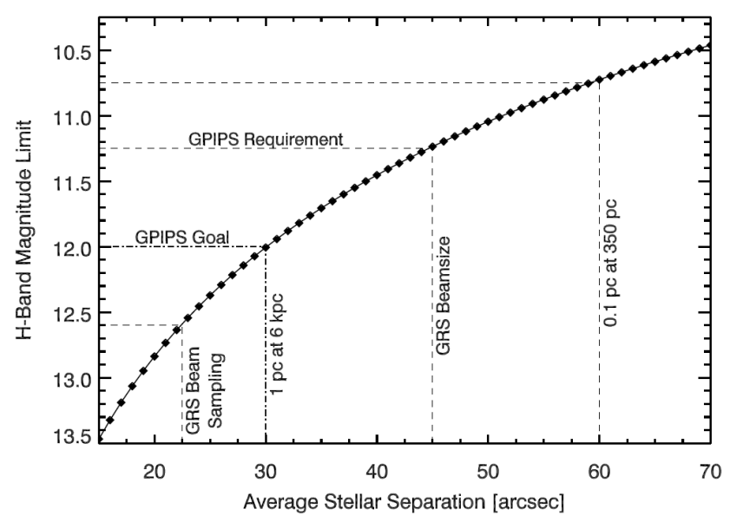
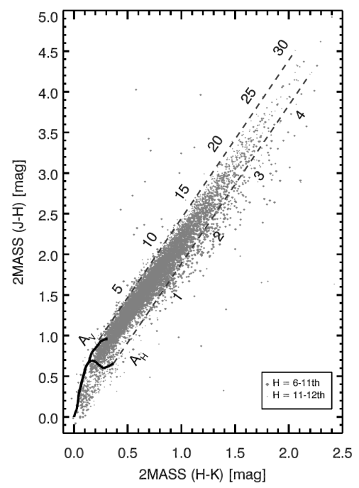
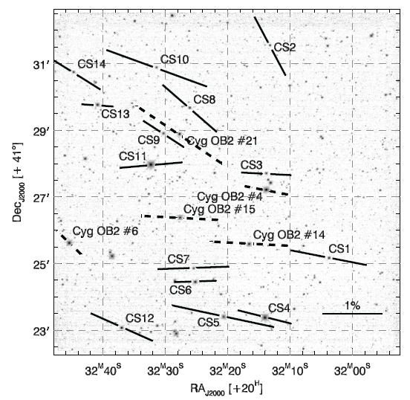
GPIPS Requirements & Goals
Sky sampling:
  Requirement: 45 arcsec sampling (to 11.25th mag)
  Goal: 30 arcsec sampling (to 12th mag)
Pol. S/N ~ 2.5 = ΔΘ < 11.5˚
Probe deeply into dark clouds, to A_{V} ~ 20+ mag
Cover Galactic Ring Survey (Jackson+ 06; ¹³CO) :
  L=18-56˚, B= -1˚ to +1˚
  3,237 Mimir FOV pointings
Well-calibrated: to 0.1% polarization ‘calibration floor’
  New, ‘Secondary’ polarization standards (Clemens+12b)
2MASS Stars

Slide 9
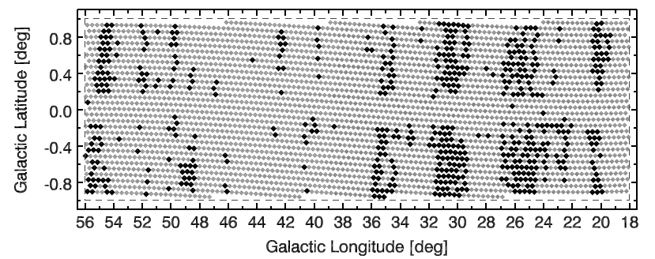
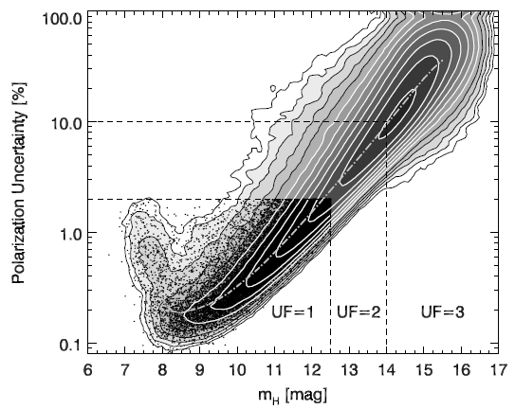
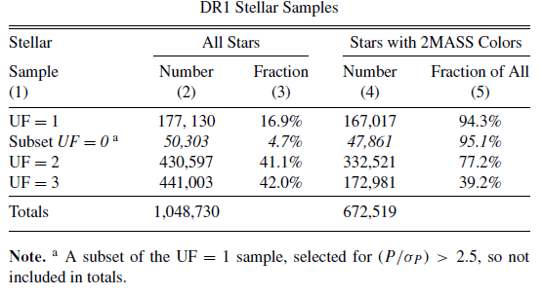
GPIPS Data Release 1 (18%; 2012): General Properties
Clemens+12c

Slide 10
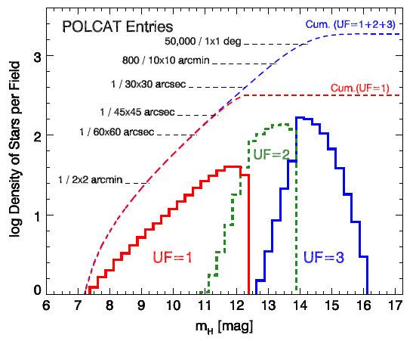
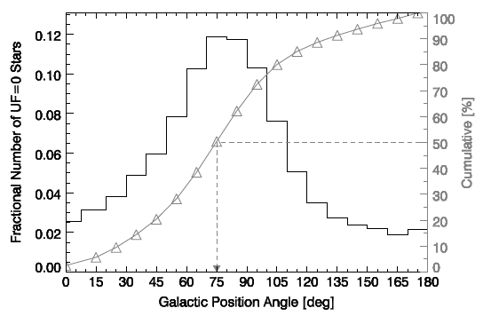
Data Release 1 Characteristics
High density of polarizations in GPIPS region
  1 star per 35 arcsec in UF=1 to 12.5th mag in H-band
Polarization directions are mostly along the disk of the Milky Way
  GPA ~ 90 deg for mid-plane
  UF0 (UF1 + S/N > 2.5) stars in DR1 show 75 deg (15 deg offset)

Slide 11
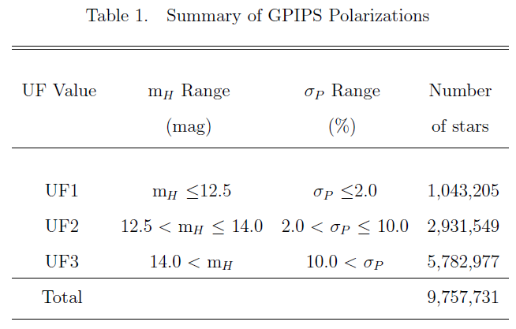
GPIPS Completed; All Data Released
Survey observations ended – Fall 2013
  Used nearly 400 telescope nights (2006 – 2013)
  Obtained > 1 million images
Data Release 2 (all data) – Spring 2014
  Science-quality data products for all 3,237 Mimir Fields
    Polarization Catalog (POLCAT) for each field
    Photometry Catalog (PHOTCAT) for each field
    Deep Image (FITS) for each field
    Postscript picture of field with high S/N vectors
    Copies of all hand-written observing logs

Slide 12
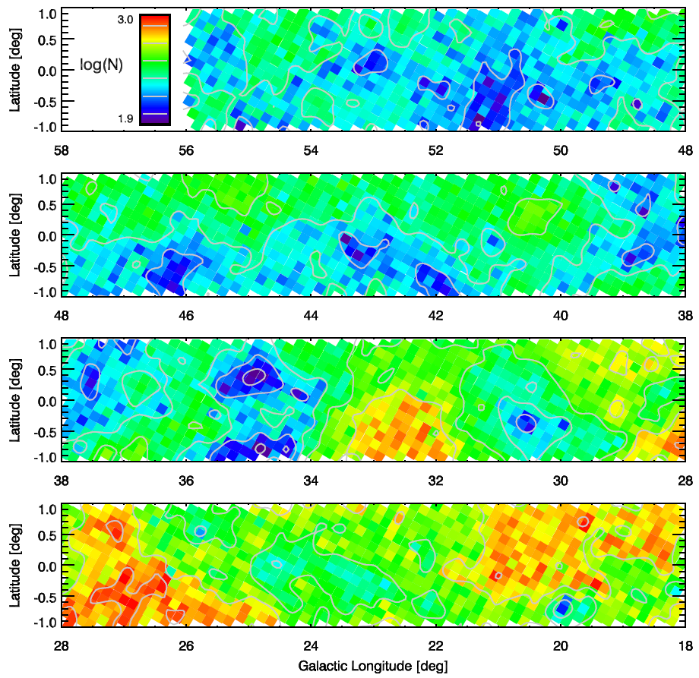
Numbers of UF1 (Highest Quality) stars per Mimir FOV (10x10 arcmin) across the GPIPS survey region
Smallest is 80 stars per field, largest is nearly 1,000 per field.
The TYPES of studies now possible are distinctly different than previously performed.

Slide 13
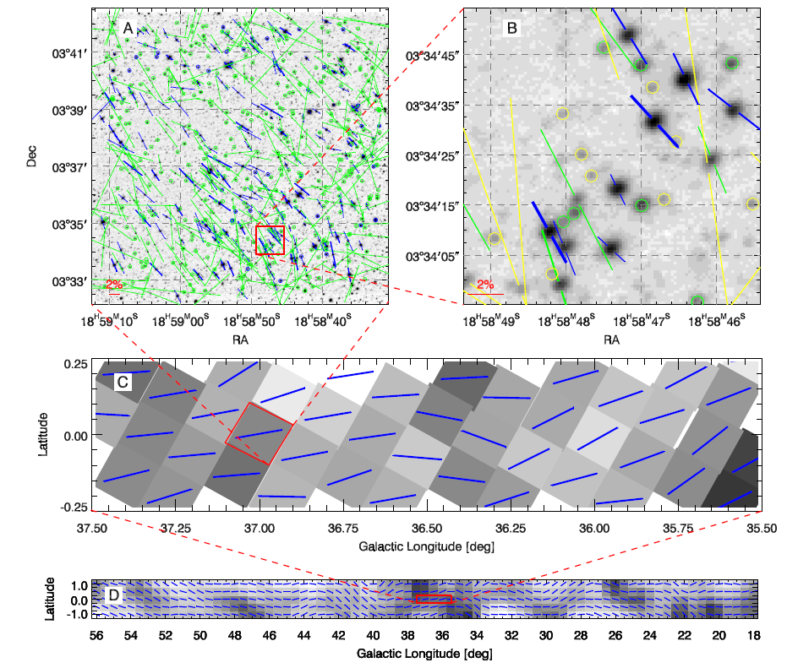
UF1
UF2
UF3
Upper
limits
UF1 Medians

Slide 14
Early Science with GPIPS (and Mimir)
Galactic magnetic dynamo model testing
  Simulations (Pavel ‘11) and observations of off-plane polarimetry (latitude cut; Pavel+ ‘12)
  Harder – fewer stars, fainter
B map for a quiescent molecular cloud
  Star formation regulation by B? (Marchwinski+ ‘12)
Testing Dust Grain Alignment models
  Lynds 204, cloud 3 (Cashman & Clemens ‘14)
B for NIR Pol of Milky Way analog galaxies
  M51 – face-on (Pavel & Clemens ’12)
  T-Galaxy – near edge-on (Clemens+ ’13)
  NGC891 – fully edge-on (Montgomery & Clemens ‘14)

Slide 15
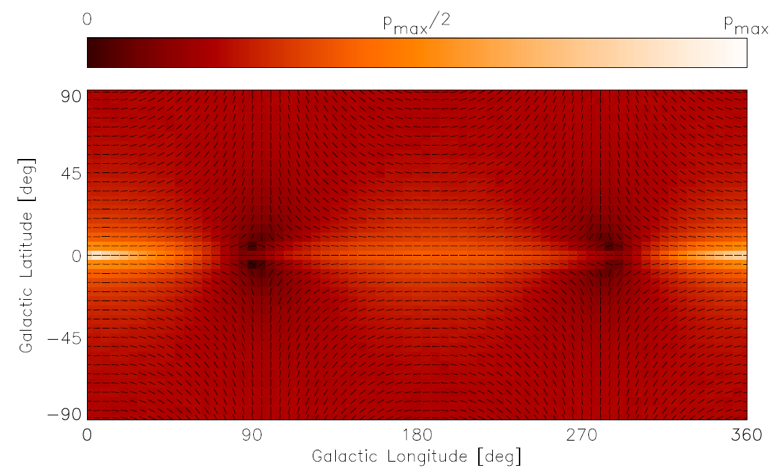
Galactic Dynamo Model Polarization Predictions
Pavel (2011) simulations to predict H-band polarizations
  Model Galactic B (Ferriére & Schmitt ‘00; Moss ‘10)
  Model dust distributions (Spergel +96; Drimmel & Spergel ‘01). (below = 1 of 24 full sky simulations)
Latitude Cut – Mimir Obs.

Slide 16
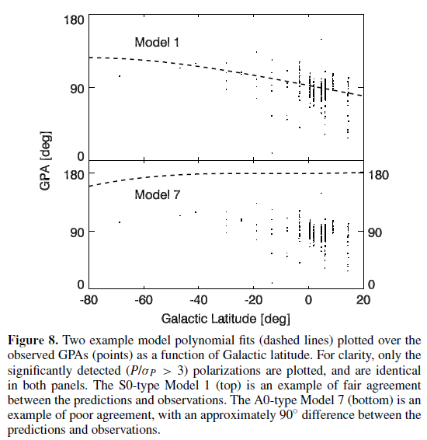
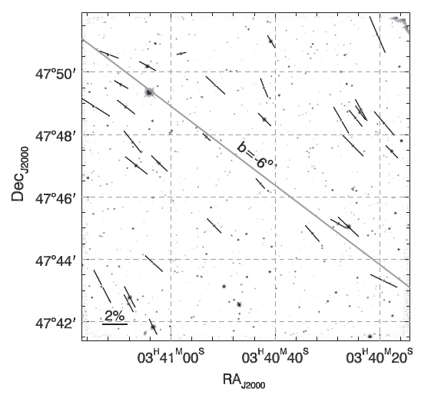
Model Testing via Mimir Observations
Observed a latitude strip (l=150) to compare to all-sky simulations.
Formally Rejected All Dynamo Models
Simulated
observations
predictions
Actual
observations
One Mimir field showing direction of Galactic plane and stellar polarization position angles
Measured ‘Spiral Pitch Angle’ of B
  -6 +/- 2 degrees
  Fairly ‘shallow’ – challenge to dynamo theory
(Pavel+ 2012)

Slide 17
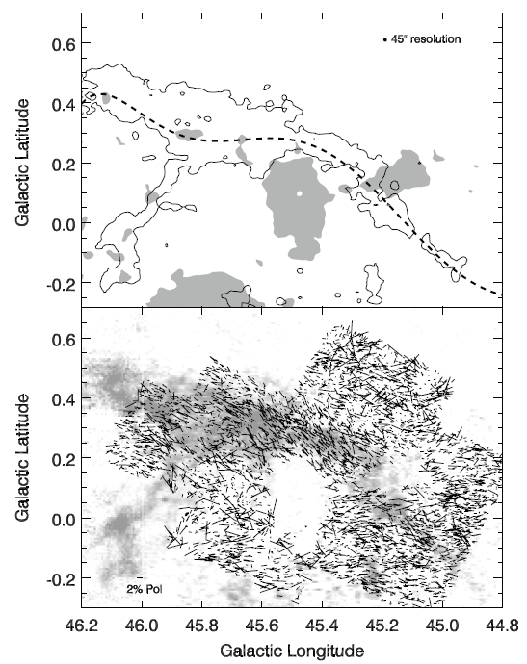
Quiescent Molecular Clouds &
Star Formation Regulation by B
Q: Does B play a role in regulating star formation?
Starting point -> quiescent clouds
  Lacking evidence of current or past star formation
UG Rob Marchwinski (+’12)
  10 x 40 pc cloud w/o stars
    ¹³CO from Galactic Ring Survey (GRS; Jackson+06)
    distance = 1.9 kpc
    mass = 1.6x10⁴ M
  early GPIPS data
    2,700 stellar polarizations

Slide 18
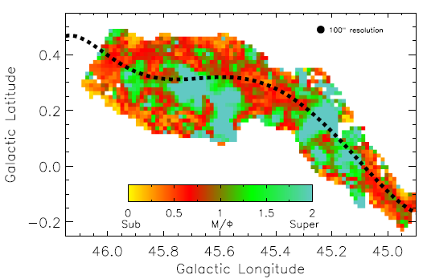
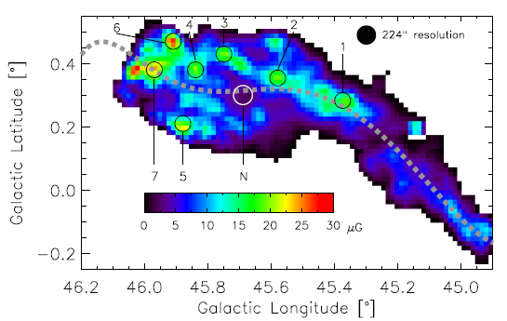
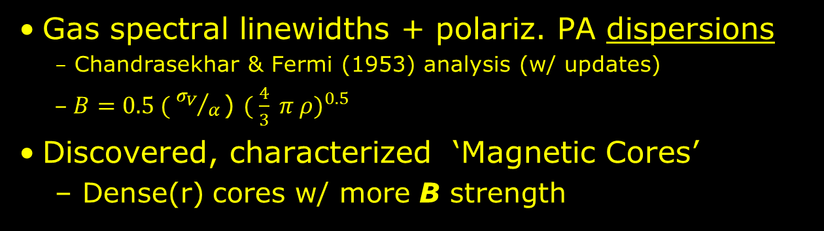
First Full Map of B Strength for a Molecular Cloud
Gas spectral linewidths + polariz. PA dispersions
  Chandrasekhar & Fermi (1953) analysis (w/ updates)
  $B=0.5 ( {σ_{V}}/{α }$) ${( \frac{4}{3} π ρ)}^{0.5}$
Discovered, characterized ‘Magnetic Cores’
  Dense(r) cores w/ more B strength
Gas Mass to B Flux (M/Φ) ratio map
Magnetic Cores are subcritical, supported against collapse by the B field.
Marchwinski et al. 2012

Slide 19
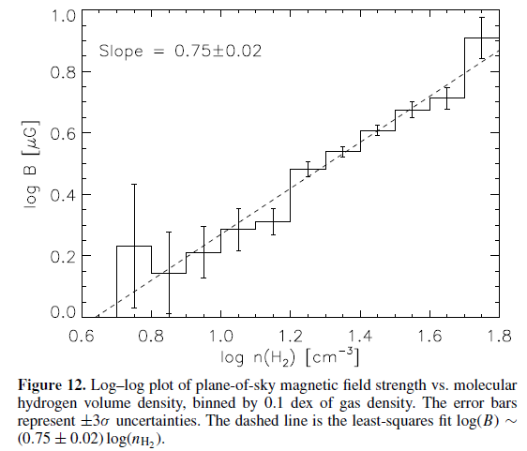
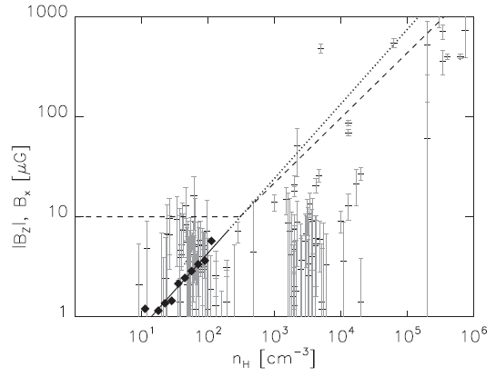
B vs n(H₂) within a single cloud
Crutcher + ‘10
Marchwinski et al. 2012

Slide 20
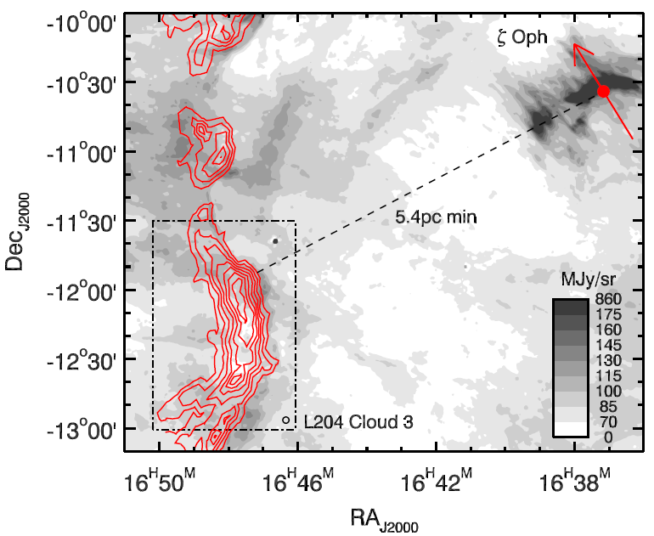
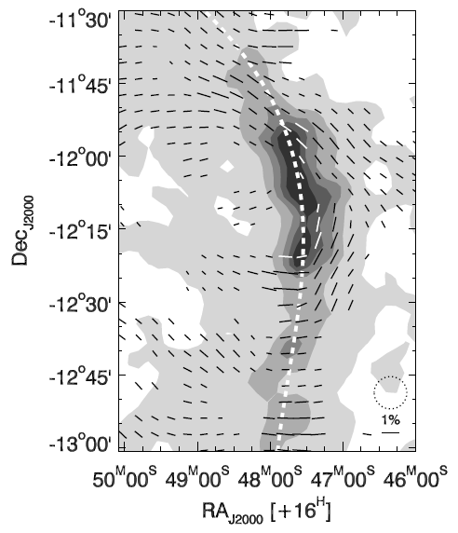
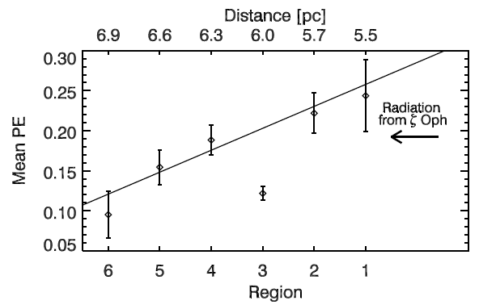
External Illumination and Dust Grain Alignment
L204, Cloud 3 in upper Sco
Illuminated by runaway O9 star ζ-Oph
Mimir H-band Pol.
  1 x 1.5 deg region
Polarization Efficiency (PE = P_{H} / A_{V}) is highest on side facing ζ-Oph, decreasing with optical depth to ζ-Oph (RATs √)
Cashman & Clemens ‘14
Gray = WISE; Red = ¹³CO (Tachihara+ ‘00)
Cashman & Clemens ‘14

Slide 21
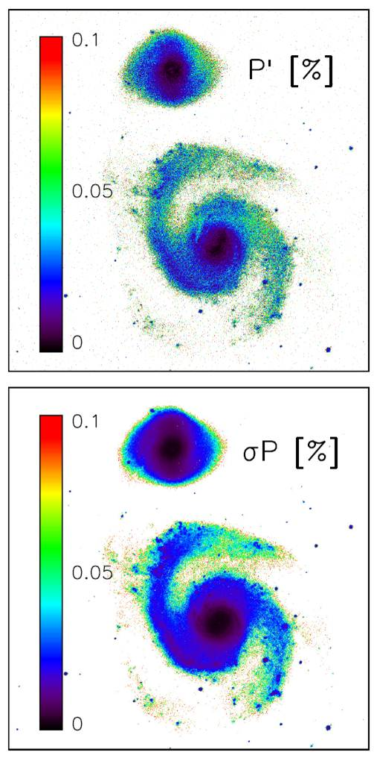
Big Picture B-Fields –
Milky Way Analog Galaxies
Hard to study large-scale B in Milky Way from WITHIN Milky Way
  Lessons from Milky Way analogs?
Lessons from radio synchrotron probes?
  synchrotron probes warm/hot plasma
  NIR gets cooler, star-forming material
M51 – face-on grand design spiral
  Strong radio, optical polarization
  But, despite deep, deep Mimir observations, we found no H-band polarization
    P_{H} < 0.05%; Pavel & Clemens 2012
  Low NIR opacity? (but high Dust to
  Gas ratio in M51…)

Slide 22
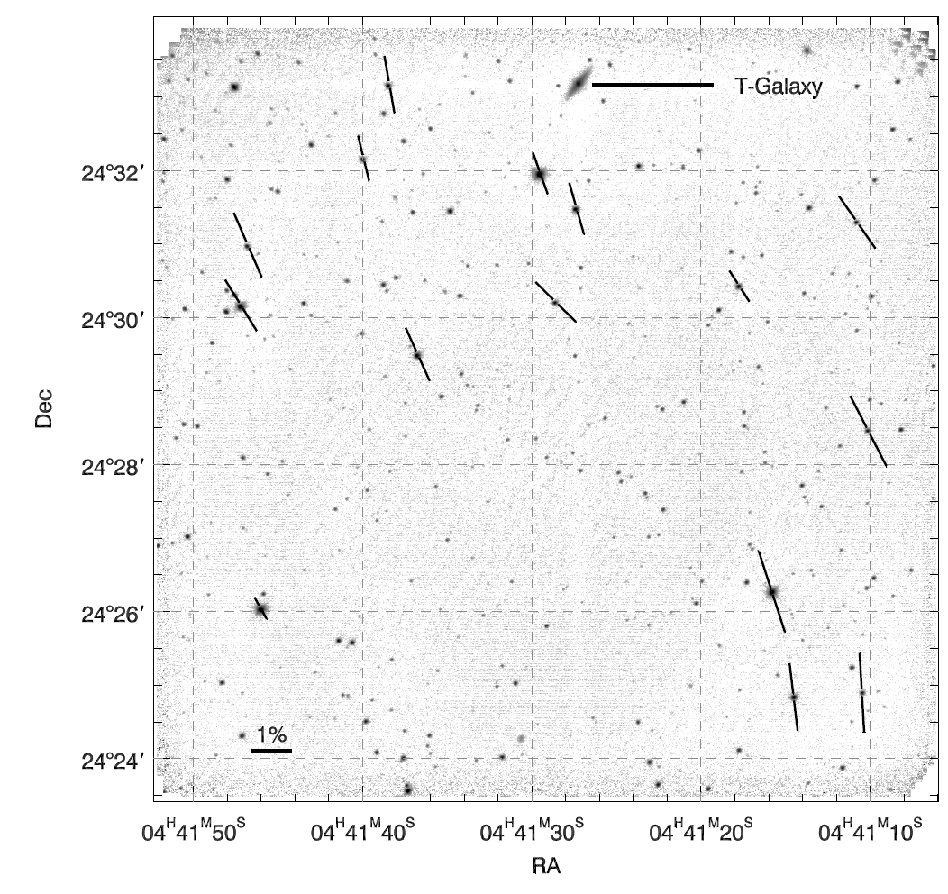
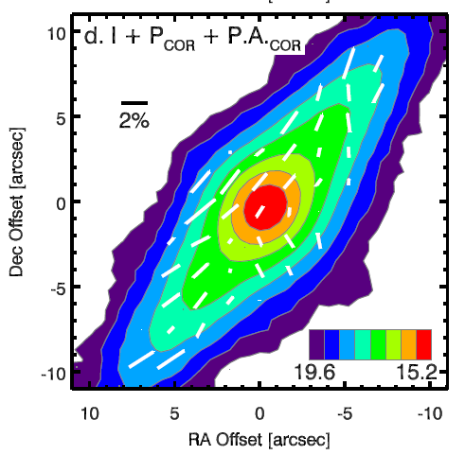
We Do Detect NIR Polarizations: The T-Galaxy
T-Galaxy – serendipitously found in deep Taurus observations
  2MASX J04412715+2433110
  53 Mpc dist.; 75˚ inclination
B lines mostly disk-parallel
Strong 1-3% polarization signal
[Clemens+13]

Slide 23
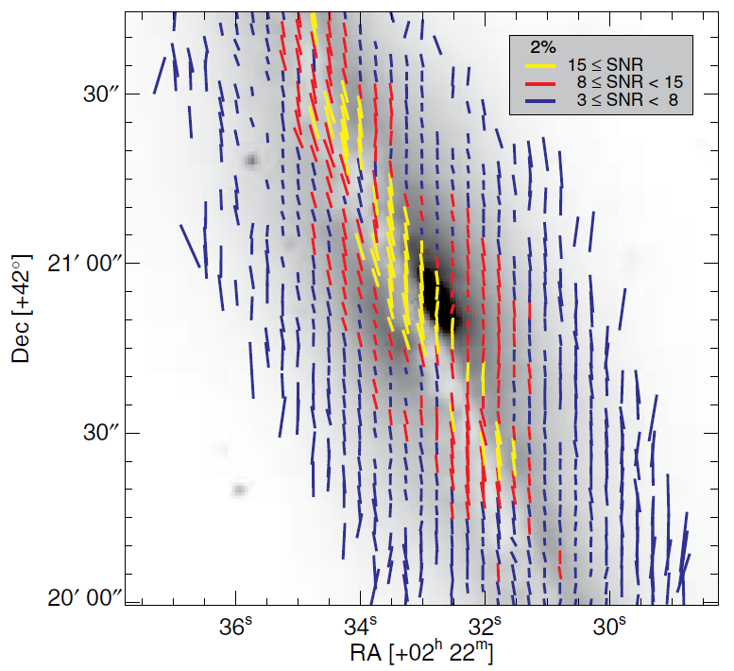
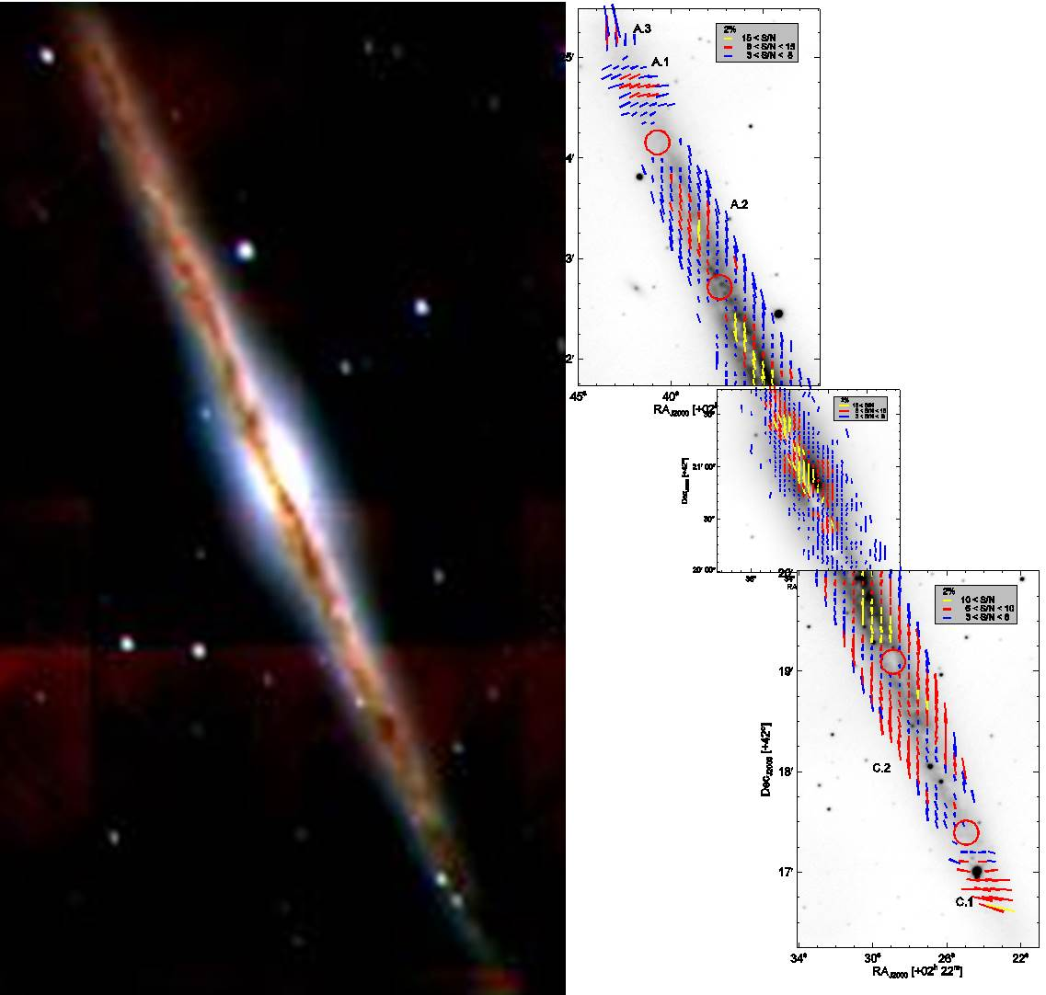
Mimir H-band & K-band Polarization Observations of NGC891 – Milky Way Analog Galaxy
NIR polarizations from
Montgomery & Clemens (2014)
15 degree offset from disk-parallel; same as seen in Milky Way
Scattering dominates at high Z-height
Dichroism along mid-plane
NIR polarization traced along the full disk extent
Detailed comparison with radio enabled
Pathfinding for PEGS PhD project of Jordan Montgomery.

Slide 24
Science Questions Under Active Pursuit
Nature of B in the cool ISM of the Galactic Disk?
  A. Overall structure of B in the first Galactic quadrant?
  B. Nature of regions departing from the overall disk field?
  C. B inside, outside of molecular clouds & cores of those clouds?
  D. Milky Way B compared to analog galaxies? (J. Montgomery)
B variations with cloud type and environment?
  E. M/Φ ratios vs cloud types and zones? (R. Cashman)
  F. B and M/Φ ratios within individual clouds? (S. Hoq)
B effects on star formation?
  K. Fraction of clouds containing ‘magnetic cores’? (R. Cashman)
  L. Do B cores exhibit alignment correlations with gas or each other?
  M. Characteristic length scales for decay of turbulence and correlation with star-forming outcomes?

Slide 25
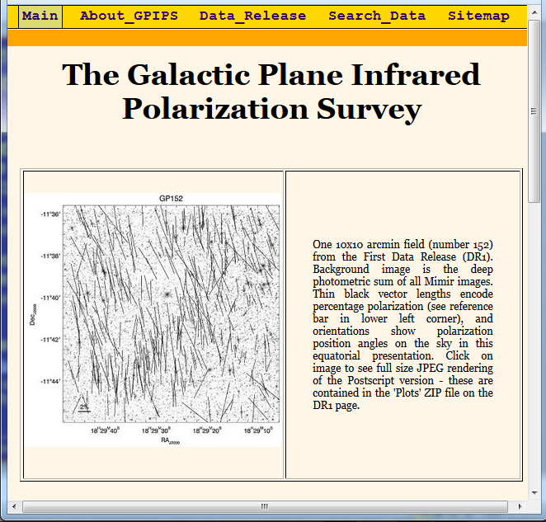

GPIPS Is: A. Done, B. for Everyone,
& C. Enables Great Science
GPIPS Observations Completed 1.0 million new H-band stellar polarizations across 76 sq deg of the inner Galactic Plane
  factor of 40-100 improvement over best previous compilations
GPIPS probes B over a wide range of environments
  Plenty of existing data for correlative studies
GPIPS data - non-proprietary
  available http://gpips0.bu.edu/
  Best ideas and uses will come from the community

