Slide 1
Fast Reconnection in Astrophysical and Laboratory Plasmas
Bhattacharjee, L. Guo, and Y-M. Huang
Center for Heliophysics
Department of Astrophysical Sciences and Princeton Plasma Physics Laboratory, Princeton University
Magnetic Fields in the Universe V, Cargese, October 5-9, 2015
Notes:
2

Slide 2

What is magnetic reconnection?
Departures from ideal behavior, represented by
break ideal topological invariants, allowing field lines to reconnect.
In the generalized Ohm’s law for weakly collisional or collisionless plasmas, R contains resistivity, Hall current, electron inertia and pressure, and ambipolar diffusion.

Slide 3
Classical (2D) Steady-State Models of Reconnection
Sweet-Parker [Sweet 1958, Parker 1957]
Geometry of reconnection layer : Y-points [Syrovatskii 1971]
Length of the reconnection layer is of the order of the system size >> width
Reconnection time scale
Solar flares:
Implicit assumption: System-size thin current sheet is stable

Slide 4
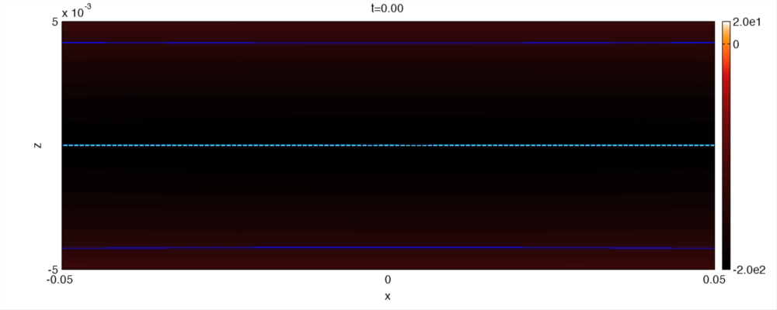
The thin current sheet is explosively stable over a critical Lundquist number, forming, ejecting, and coalescing a hierarchy of plasmoids.
B., Huang, Rogers and Yang 2009, Huang and B. 2010

Slide 5
A little history
Secondary tearing instability of high-S current sheet has been known for some time (Bulanov et al. 1979, Lee and Fu 1986, Biskamp 1986, Matthaeus and Lamkin 1986, Yan et al. 1992, Shibata and Tanuma 2001), but its precise scaling properties were determined only recently (Loureiro et al. 2007, Bhattacharjee et al. 2009)
The instability is ubiquitous: it has been studied recently nonlinearly in fluid (Lapenta 2008, Cassak et al. 2009; Samtaney et al. 2009, Huang et al. 2010, Barta and Buechner 2010) as well as fully kinetic studies with a collision operator (Daughton et al. 2009).

Slide 6
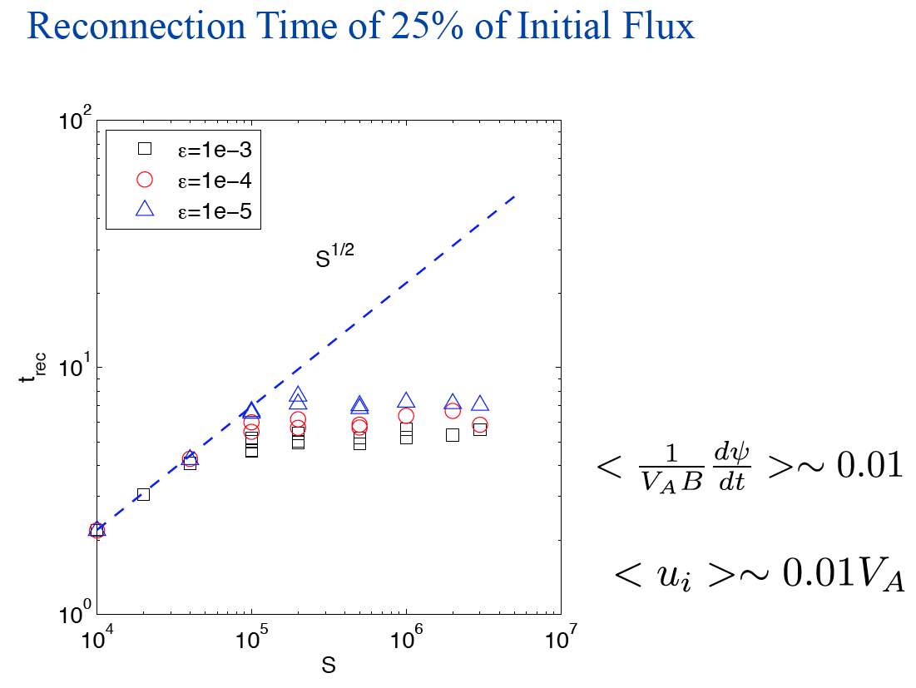

Slide 7
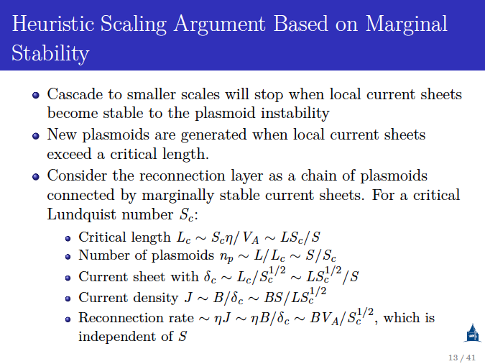

Slide 8
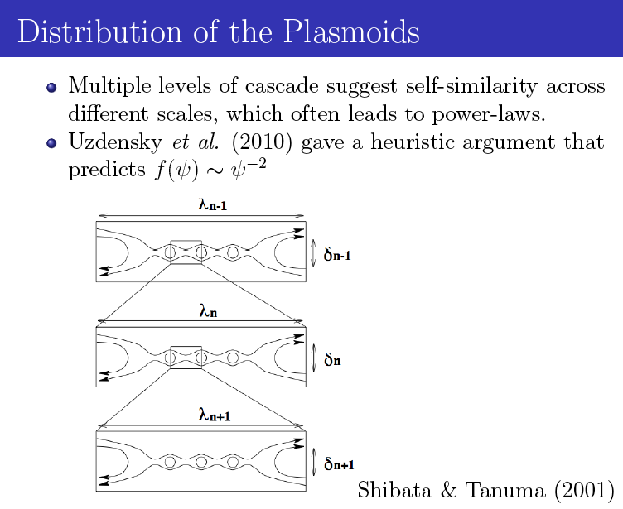

Slide 9
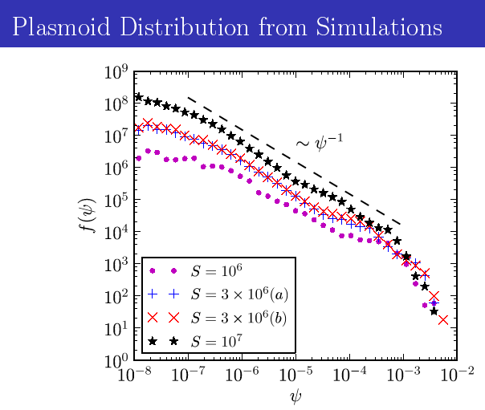
Huang
and B.,
PRL,
2012

Slide 10
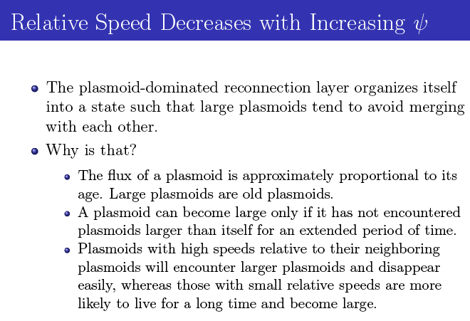

Slide 11
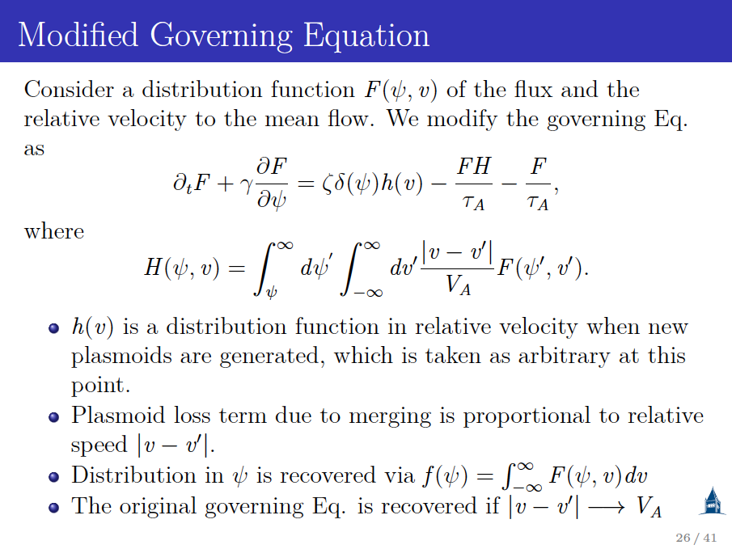

Slide 12
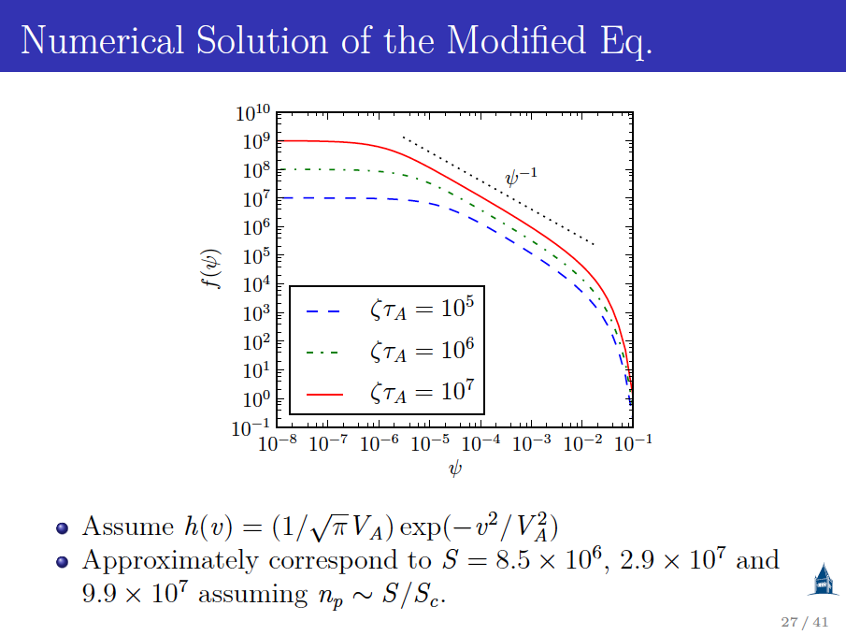

Slide 13
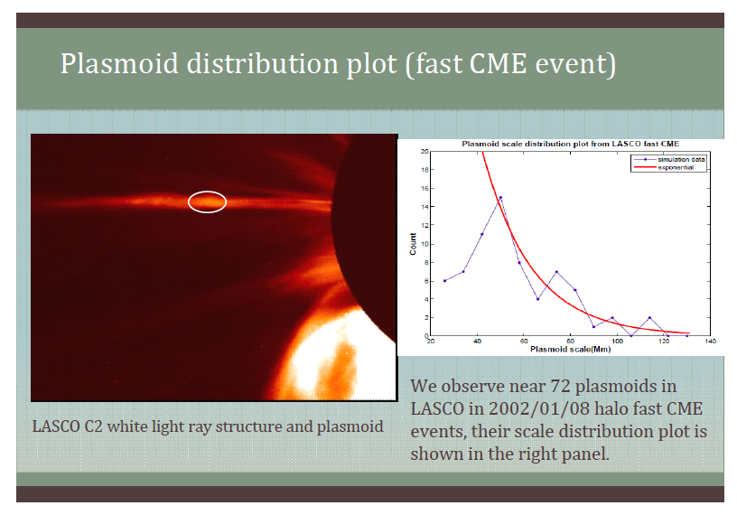

Slide 14
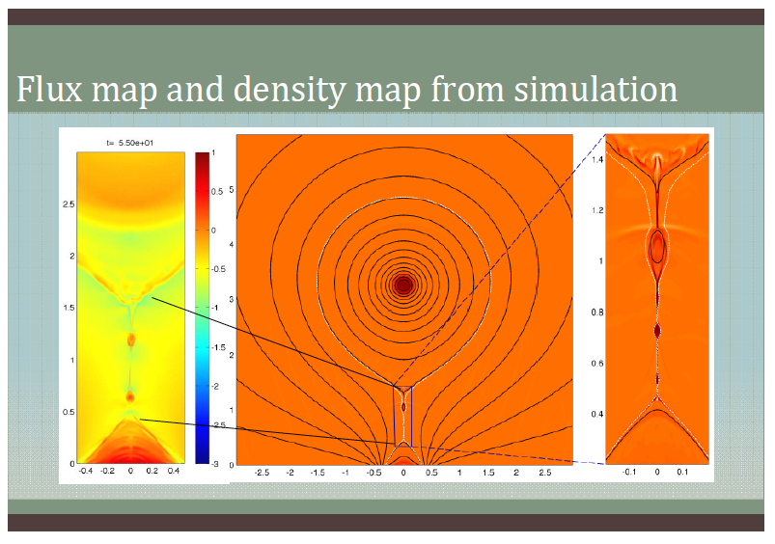


Slide 15
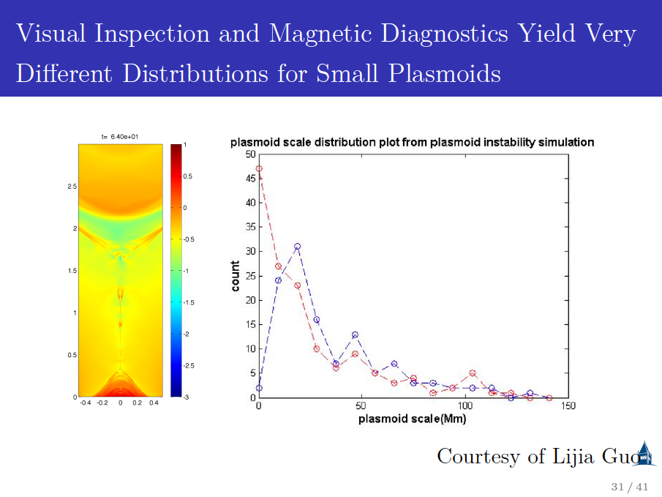

Slide 16
Hall MHD (or Two-Fluid) Model and the
Generalized Ohm’s Law
In high-S plasmas, when the width of the thin current sheet ( ) satisfies
(or
if there is a guide field)
“collisionless” terms in the generalized Ohm’s law cannot be ignored.
Generalized Ohm’s law (dimensionless form)
Electron skin depth
Ion skin depth
Electron beta

Slide 17
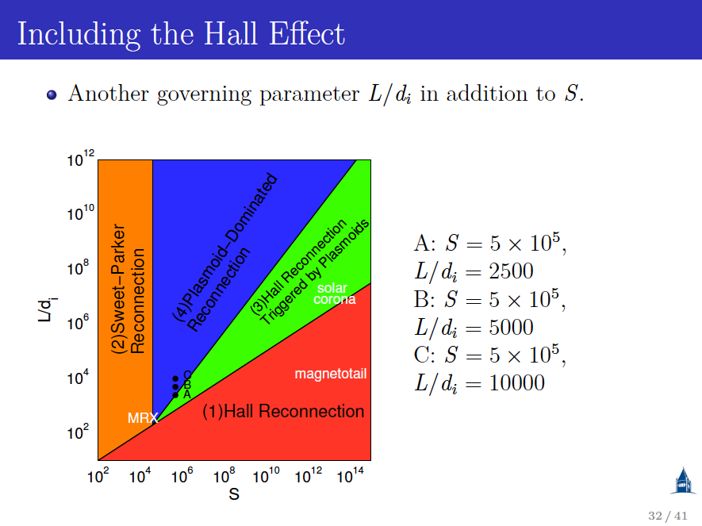

Slide 18
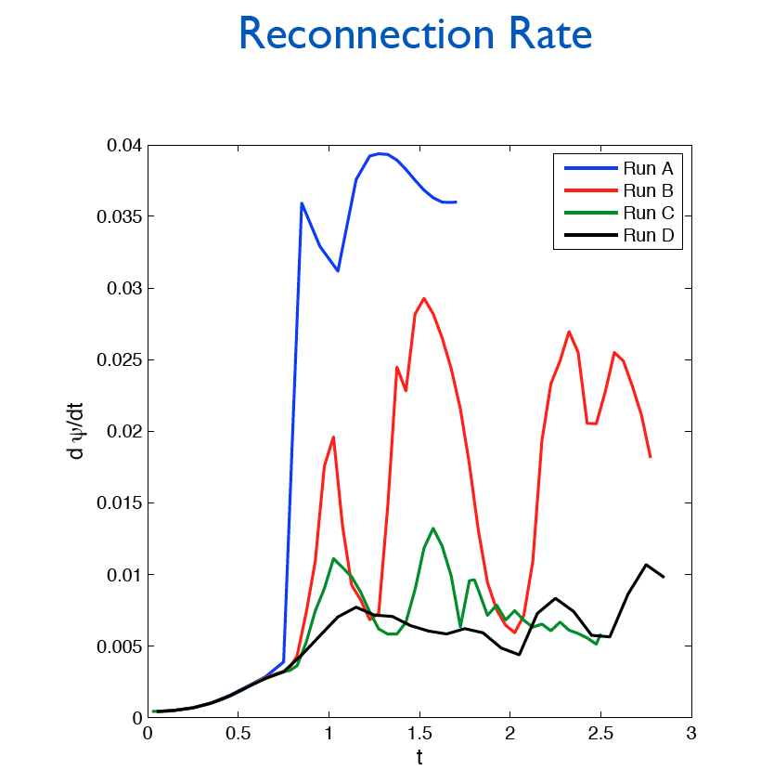

Slide 19
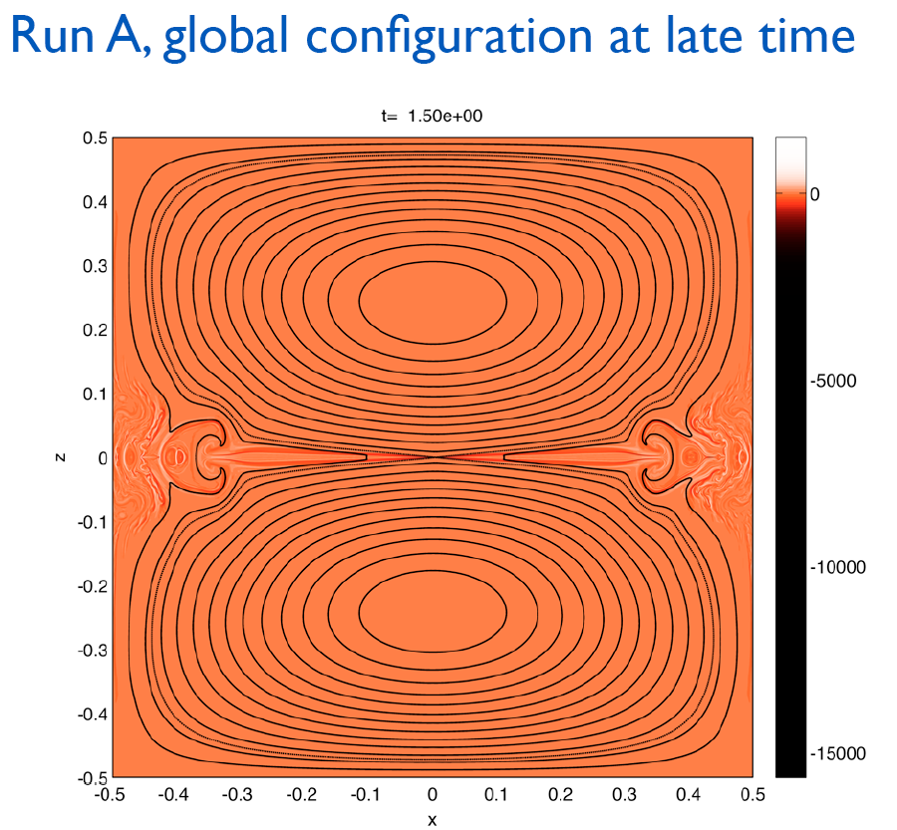

Slide 20
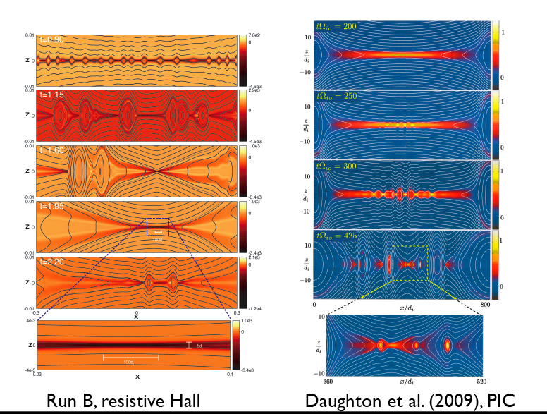
Largest 2D Hall MHD simulation to date

Slide 21
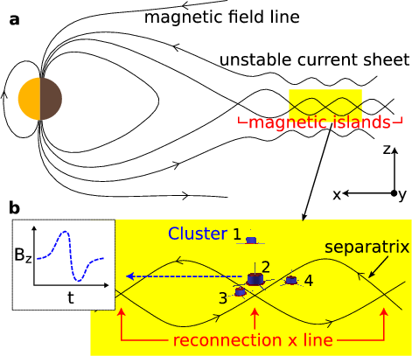
Fluxes of energetic electrons peak within magnetic islands
[Chen et al., Nature Phys., 2008]

Slide 22
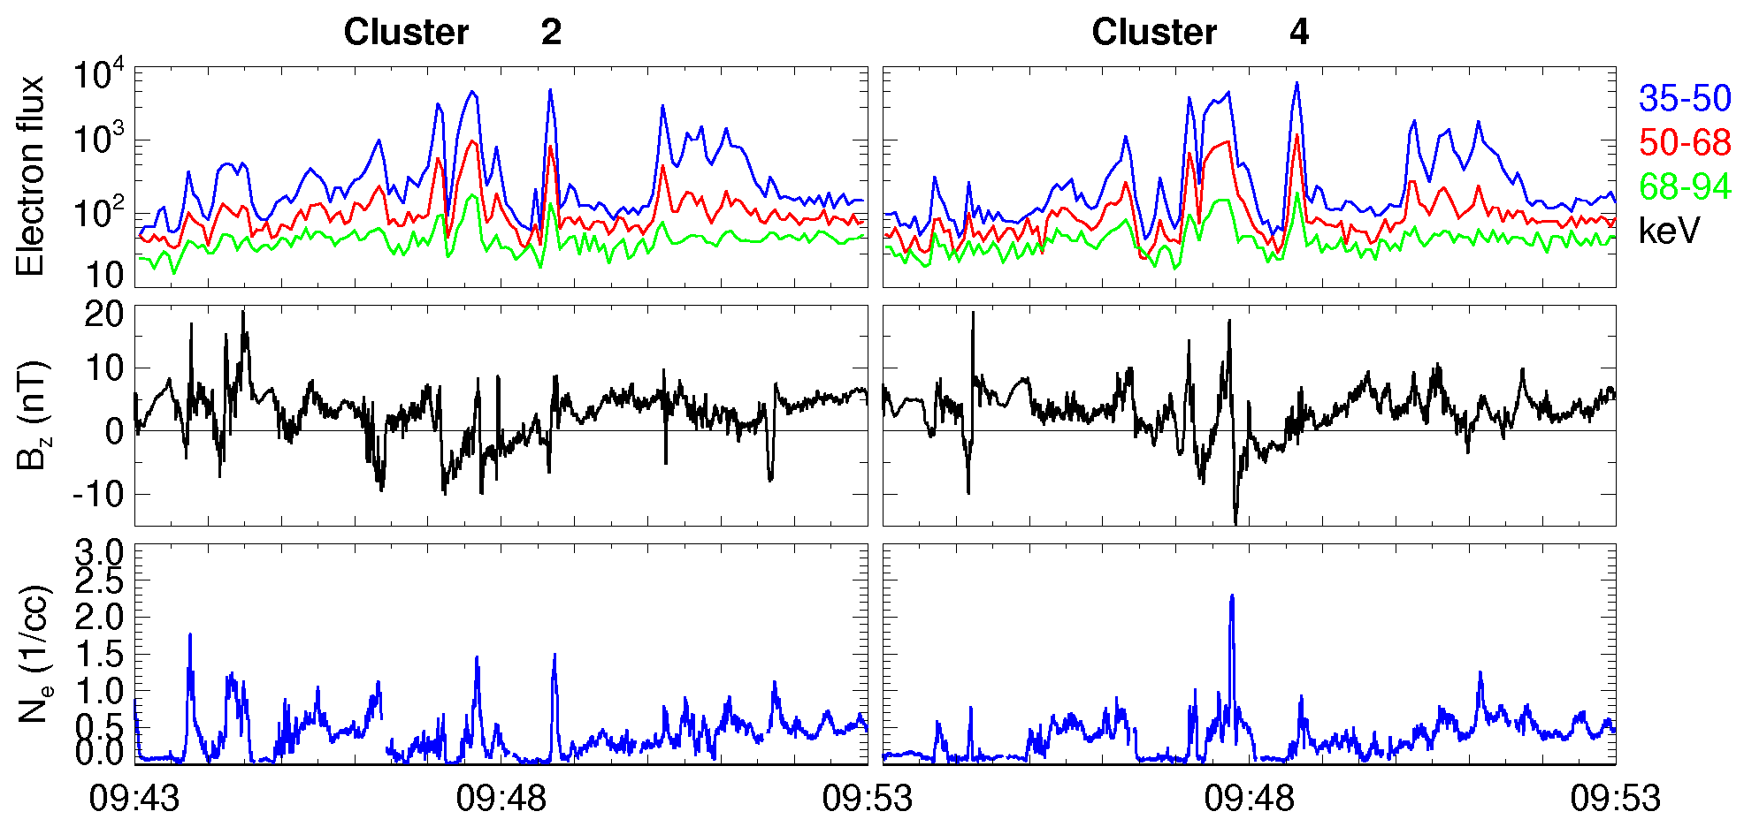
e bursts & bipolar Bz & Ne peaks
~10 islands within 10 minutes

Slide 23
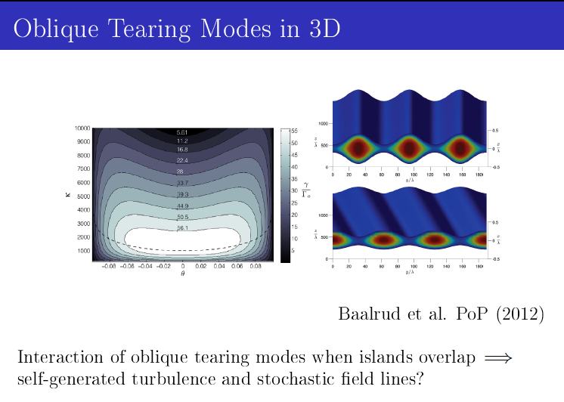
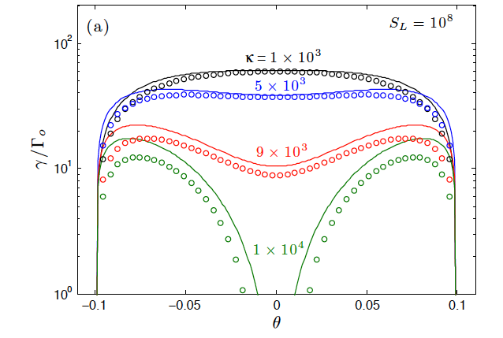

Slide 24
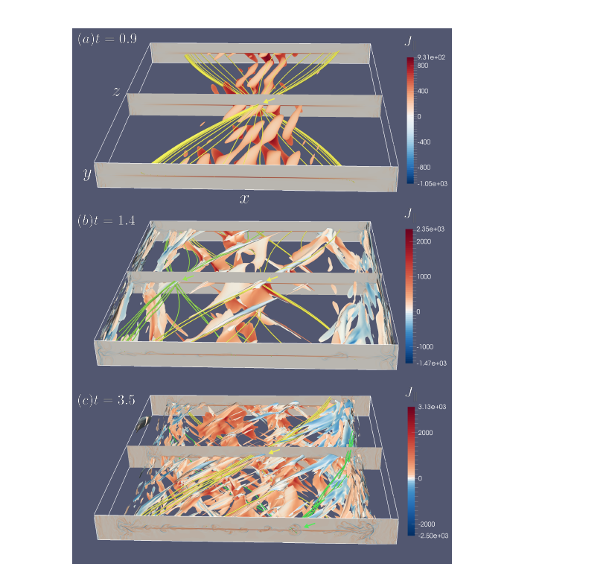

Slide 25
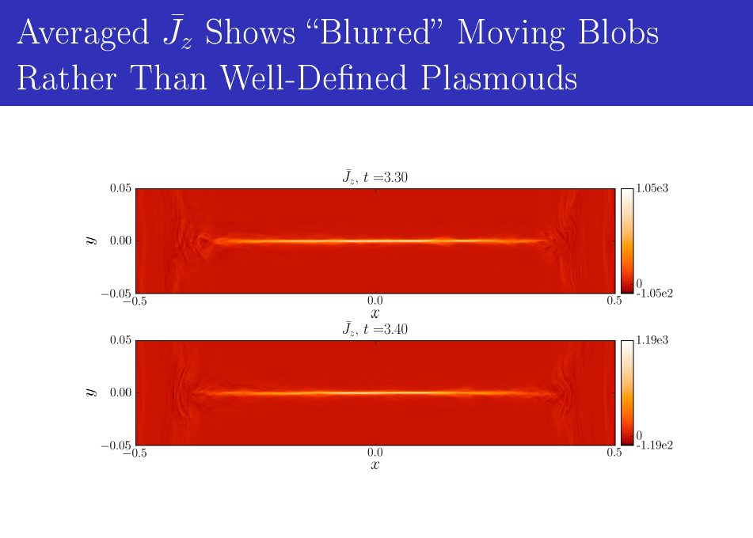

Slide 26
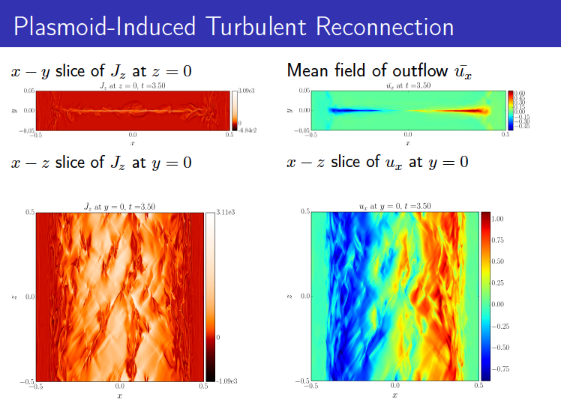

Slide 27
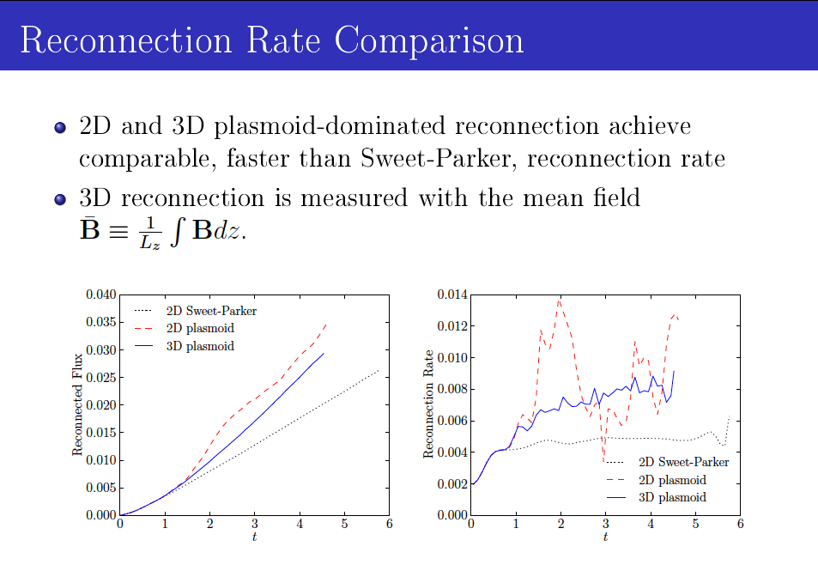

Slide 28
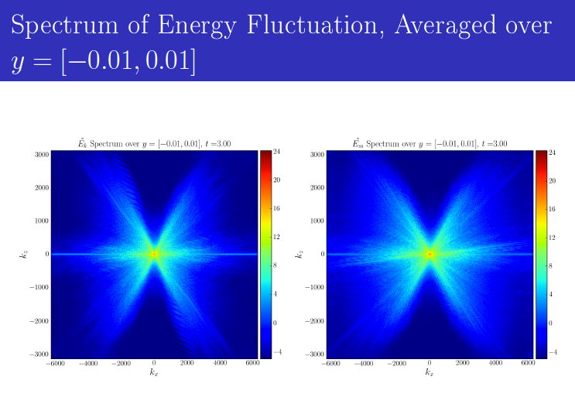

Slide 29
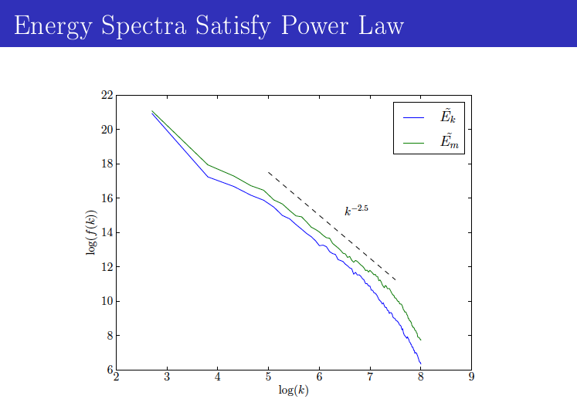
Connection with weak turbulence scaling law of Ng and B. (1996),
Galtier et al. (2000) (~ )?

Slide 30
Summary
Thin current sheets are fragile, and spontaneously unstable with respect to the plasmoid instability in large systems, substantially exceeding Sweet-Parker rates within the realm of resistive MHD, without invoking Hall current or 2D/3D turbulence (Matthaeus and Lamkin 1986, Loureiro et al. 2009, Lazarian and Vishniac 1999, Kowal et al. 2009). The peak reconnection rate is very weakly dependent on the Lundquist number.
The plasmoid distribution follows a power law
The power-law appears under-resolved in post-CME current sheet observations, which exhibit an exponential tail.
A new phase diagram for fast reconnection is obtained.

Slide 31
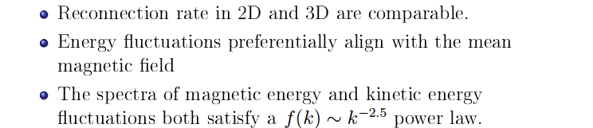
Summary (continued)
Unresolved question: It seems easy, almost too easy,
to excite the plasmoid instability. Hence, transition to fast
reconnection, mediated eventually by Hall effects, is easy. How
can we then account for the quiet phase, which can be long-lived,
when energy is stored before it can be released by reconnection?

