Slide 1

Cosmic Magnetism with the
Square Kilometre Array and its Pathfinders
CSIRO / Swinburne ;
Mihos / Huey / Science
Bryan Gaensler
University of Toronto
Canadian SKA
Science Director
@SciBry #MFU5

Slide 2
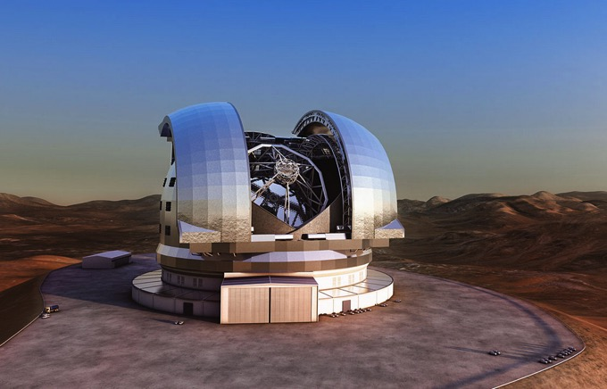
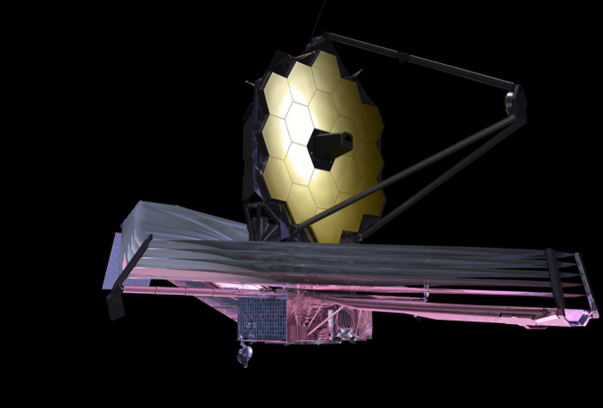
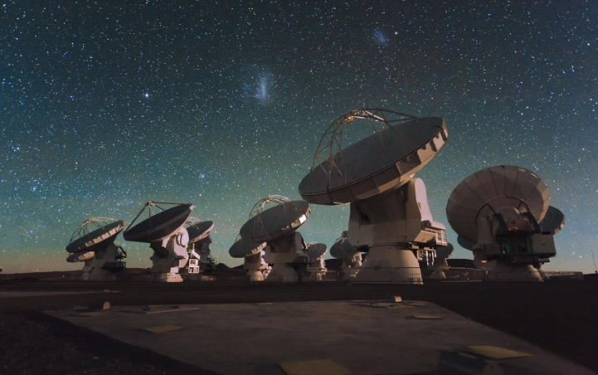
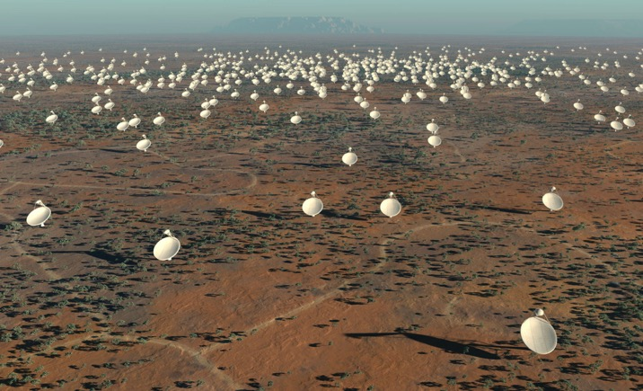
Great Observatories for the Next Decade
Optical: TMT, GMT, E-ELT
Infrared: JWST
Millimetre/sub-mm: ALMA
Radio: Square Kilometre Array

Slide 3
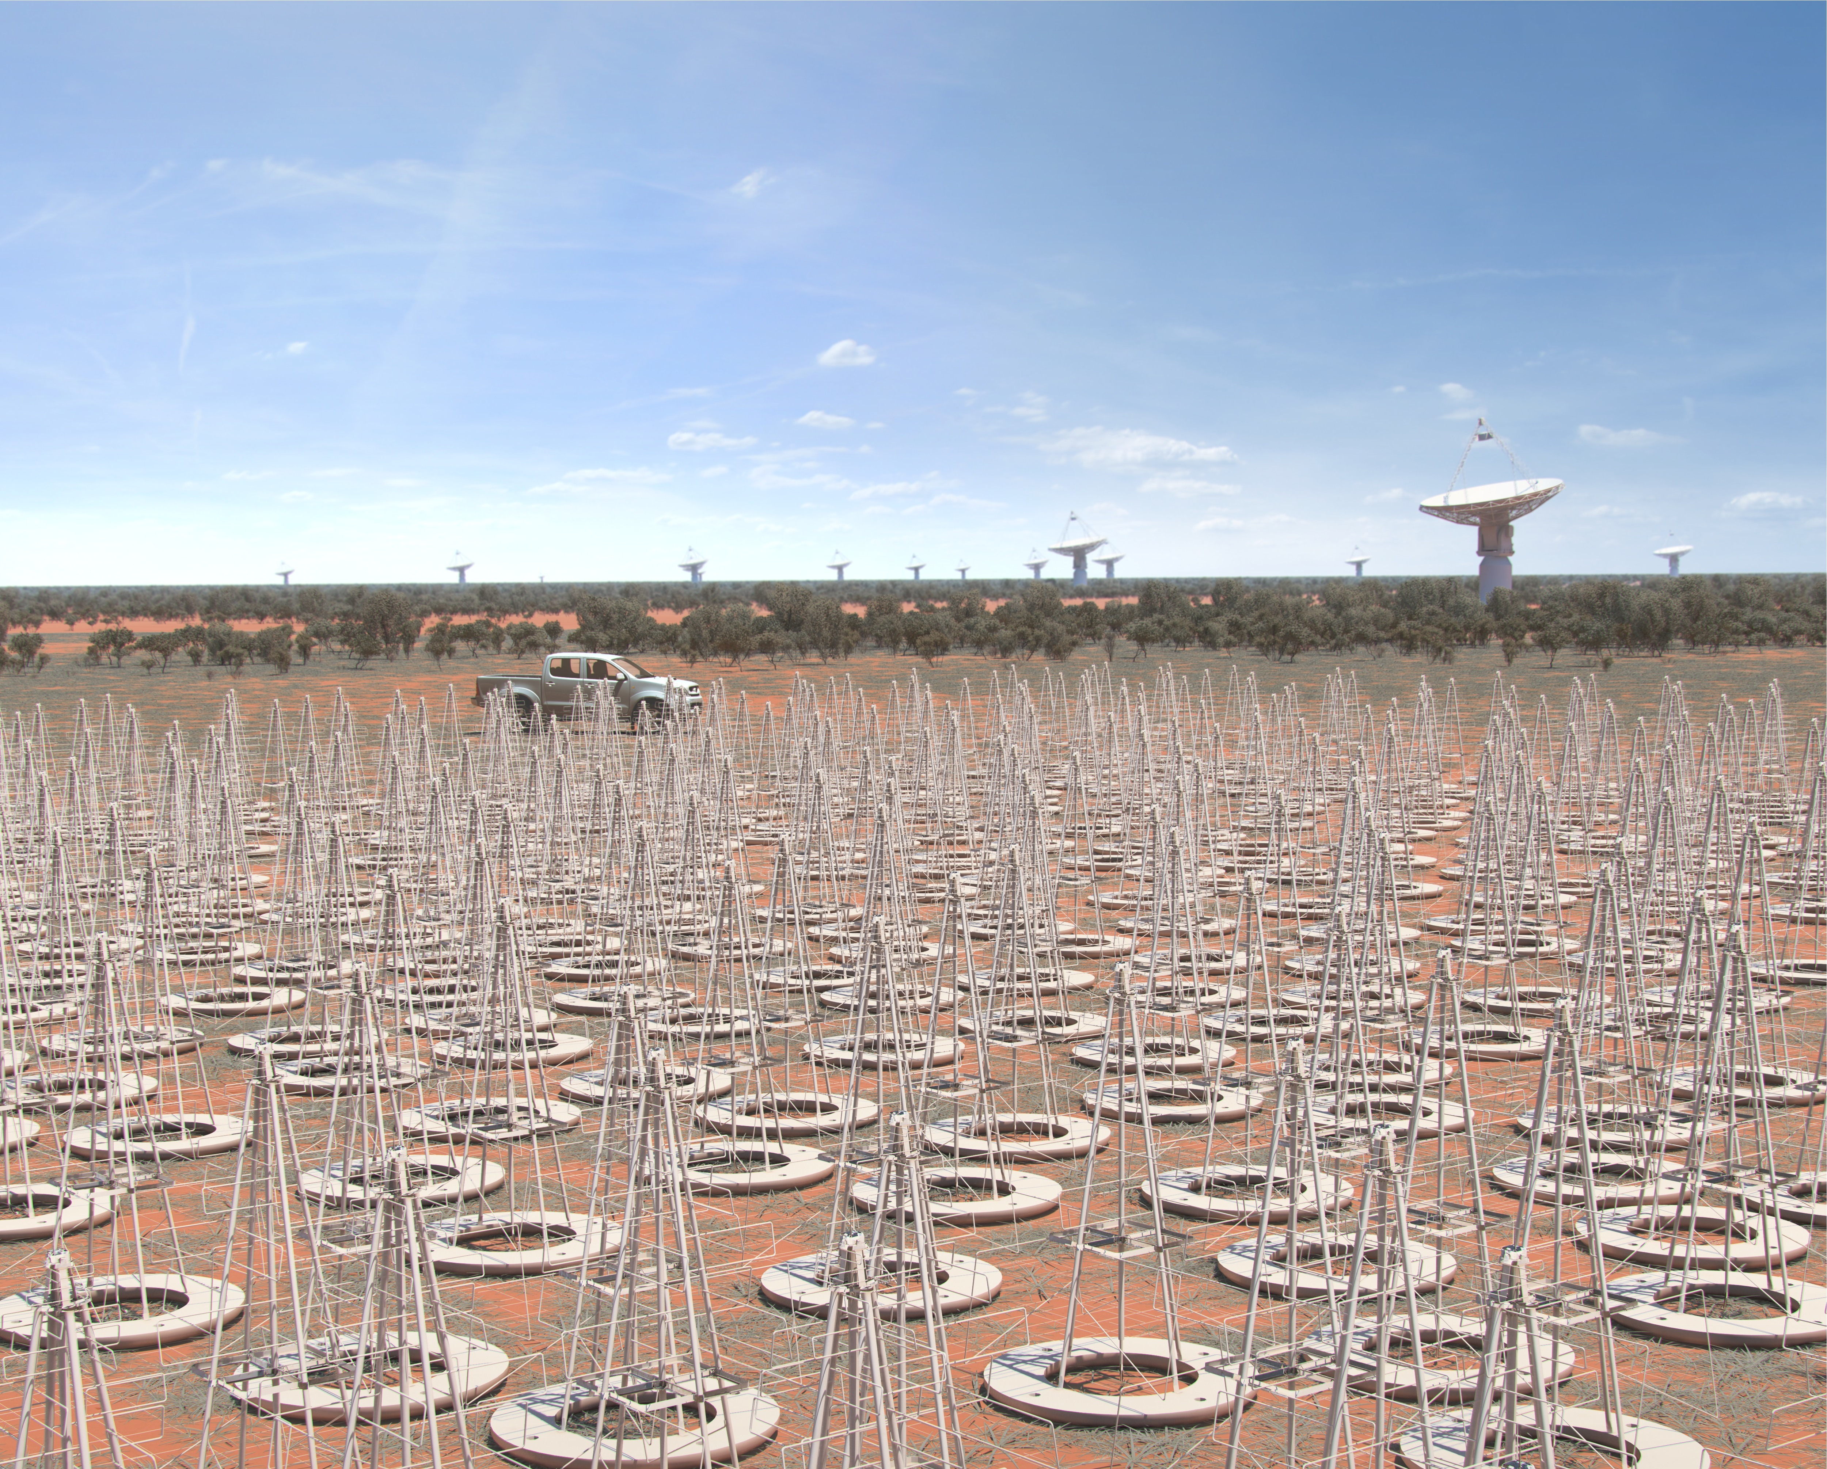
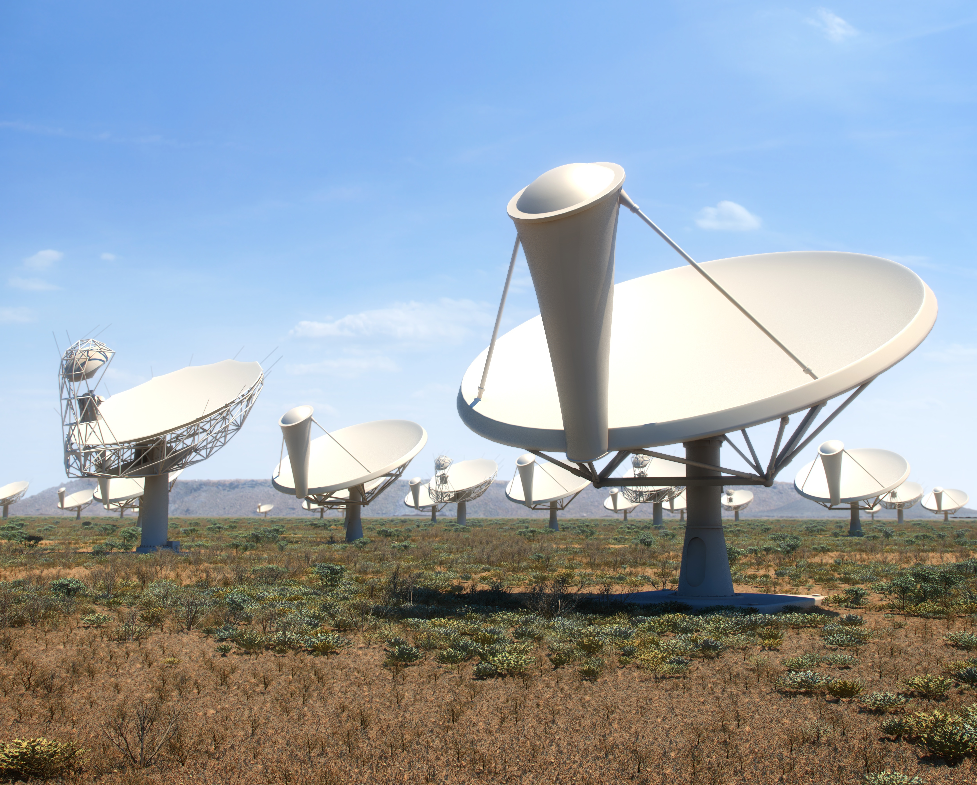
The Square Kilometre Array
Vision: world’s most powerful radio telescope
  10 member countries: AU, CA, CN, IN, IT, NL, NZ, SE, ZA, UK
  Observers and other participants: BR, DE, ES, FR, JP, KR, MT, PL, PT, RU, US
2012: site decision; 2015: final baseline design for SKA1 (first ~10%)
  SKA1-Low in Australia: 130,000 dipoles, 50-350 MHz
  SKA1-Mid in South Africa: 200 dishes, 0.35-14 GHz
  Sensitivity: 8 x LOFAR, 5 x JVLA; resolution: 1.25 x LOFAR, 4 x JVLA
  Survey speed: 135 x LOFAR, 60 x JVLA
SKA Organisation

Slide 4
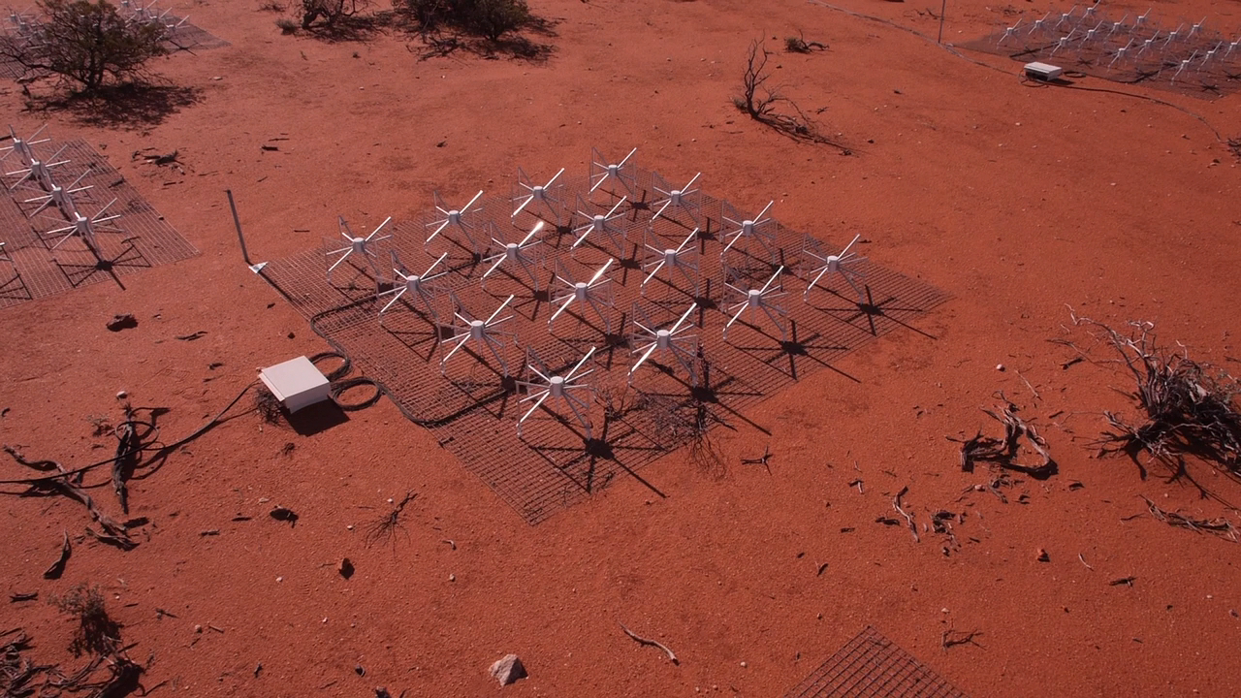
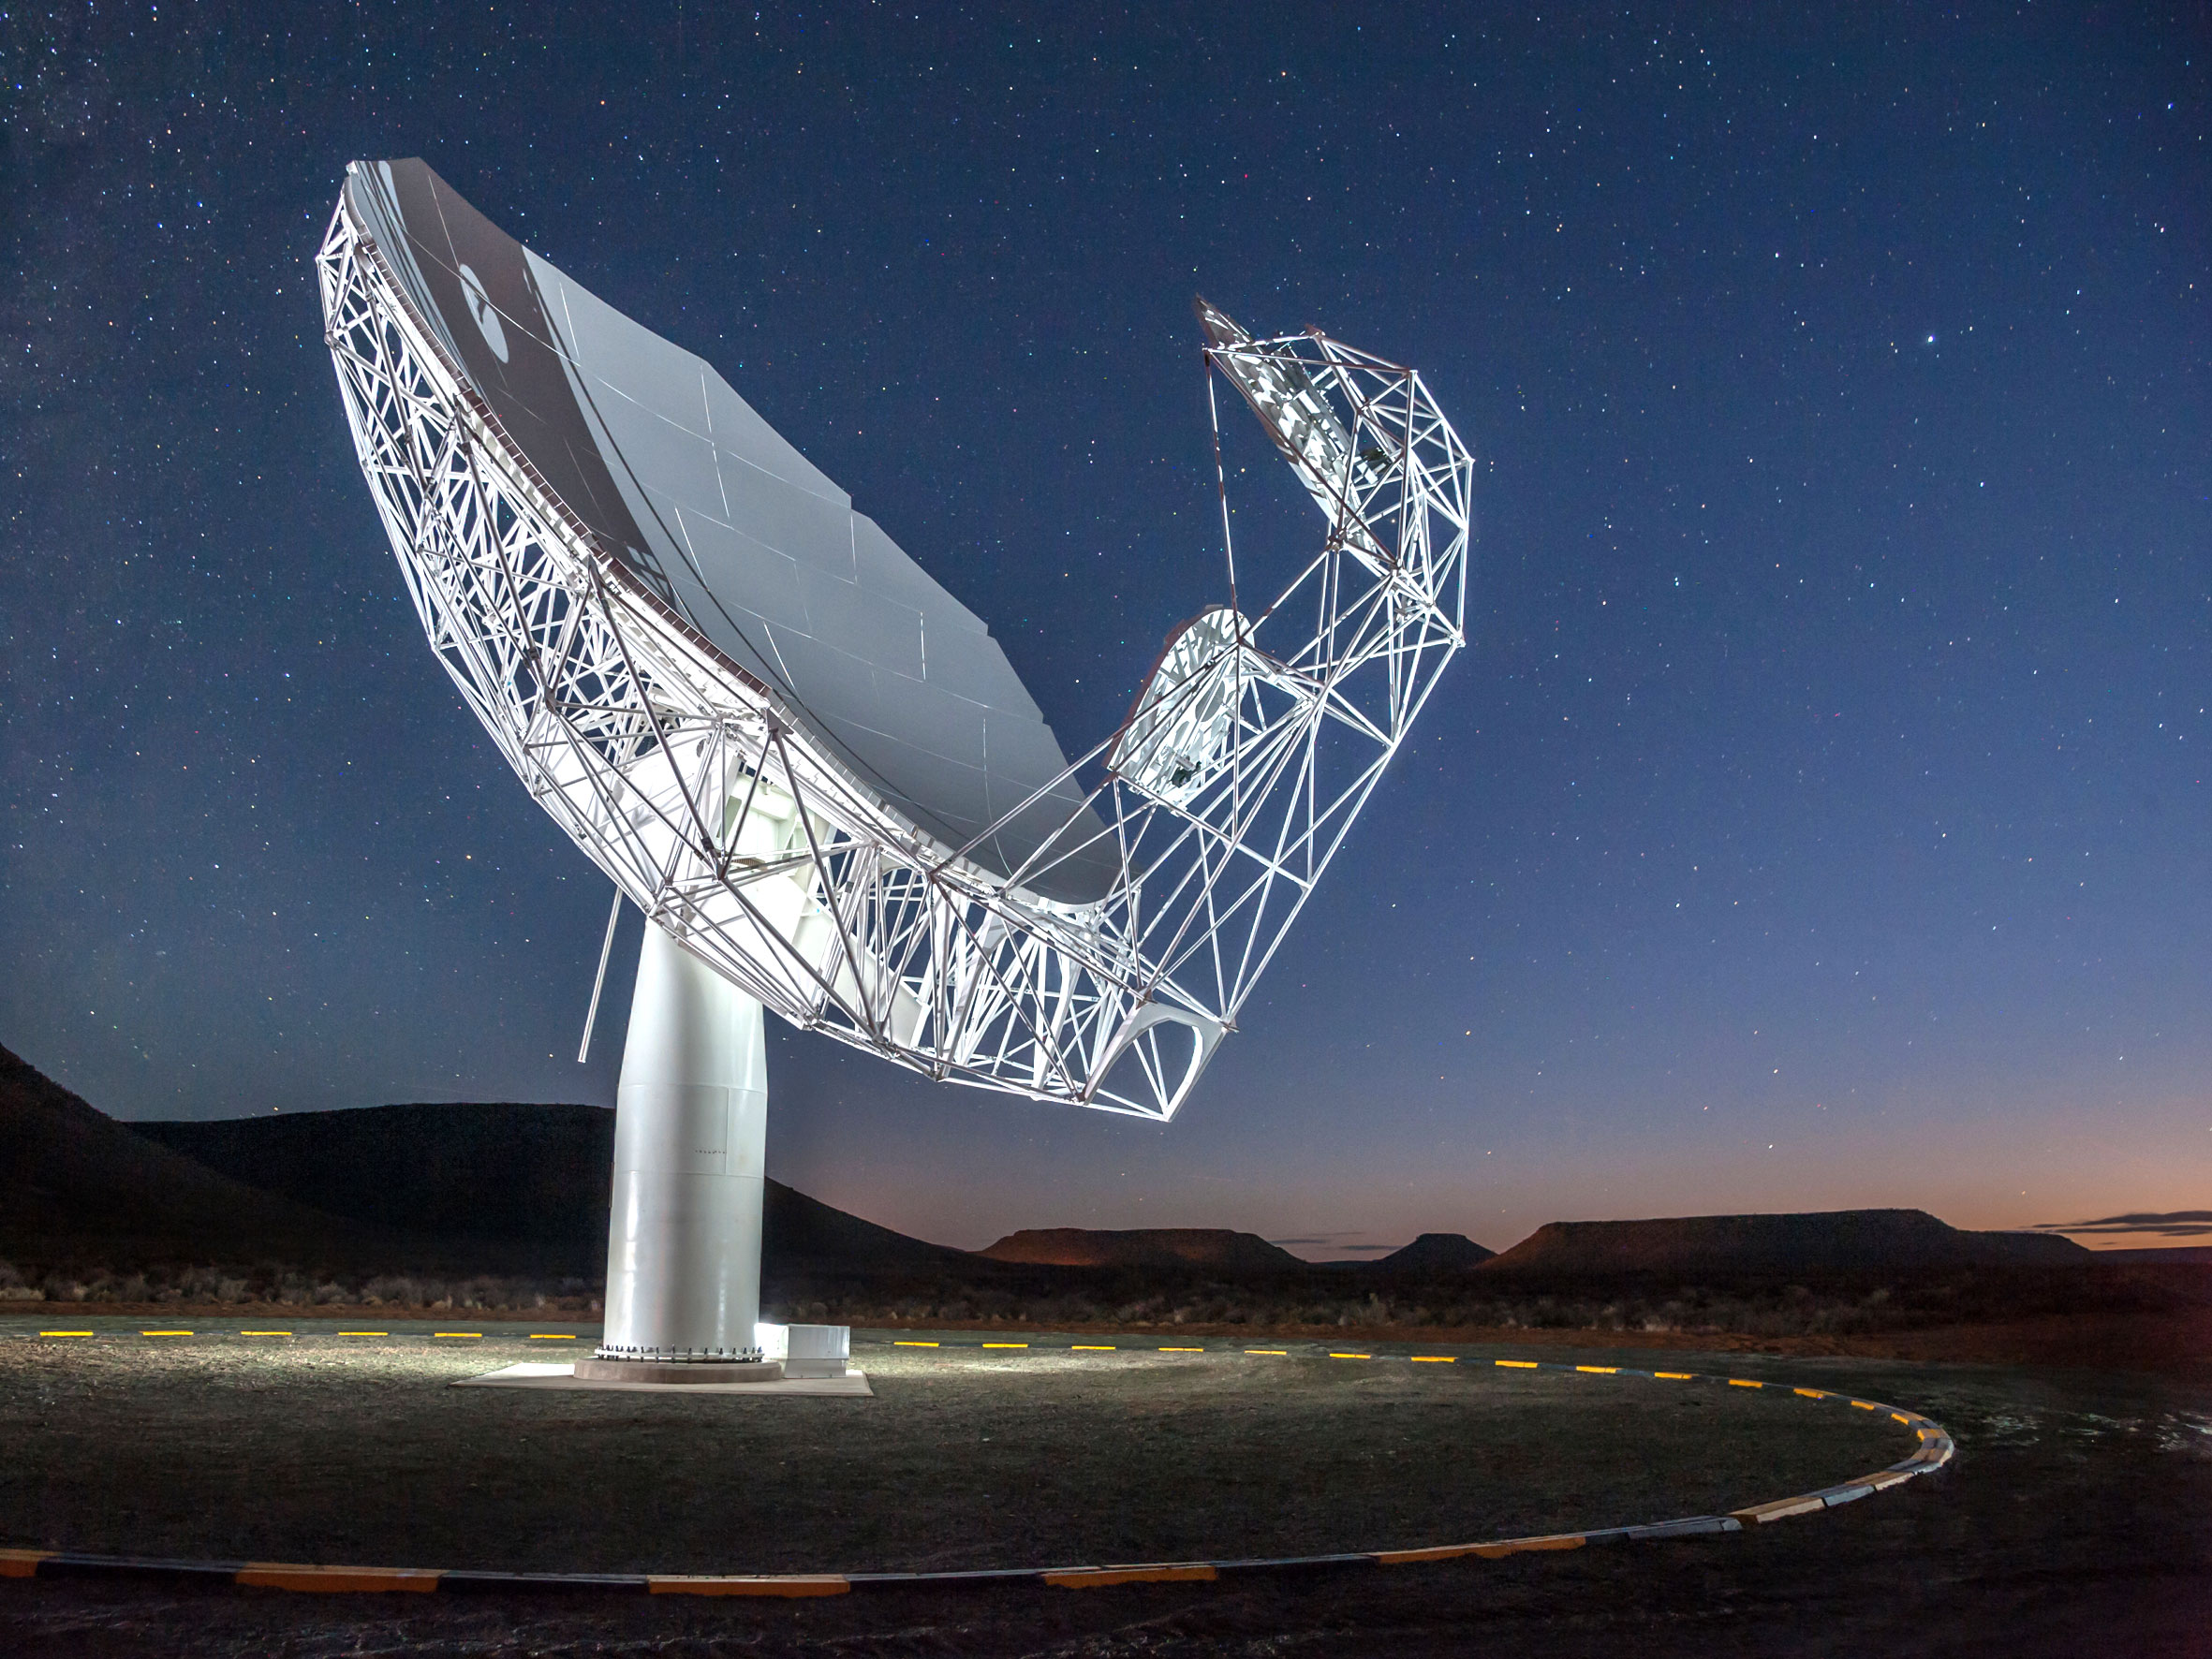
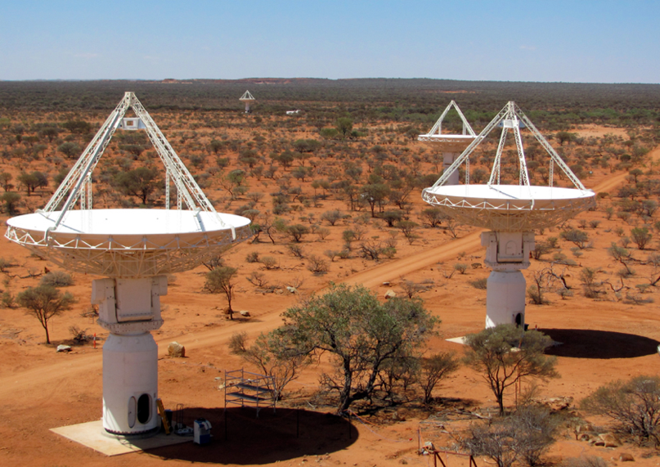
SKA: Pathfinders & Timeline
2013-2020 : SKA pathfinders
  Murchison Widefield Array (Australia)
  MeerKAT (South Africa)
  Australian SKA Pathfinder (Australia)
2018-2023 : SKA1 construction
and early science
2024 : SKA2 construction begins
(~10x SKA1)
MWA
BBC Two Horizon
MeerKAT
ASKAP
SKA South Africa
Ant Schinckel (CSIRO)

Slide 5
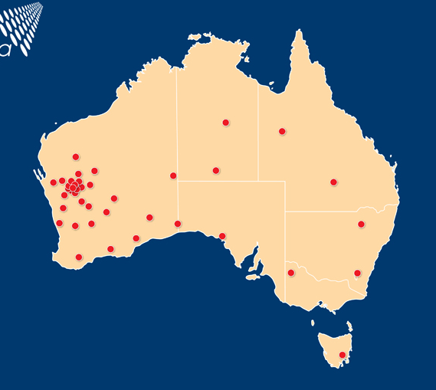
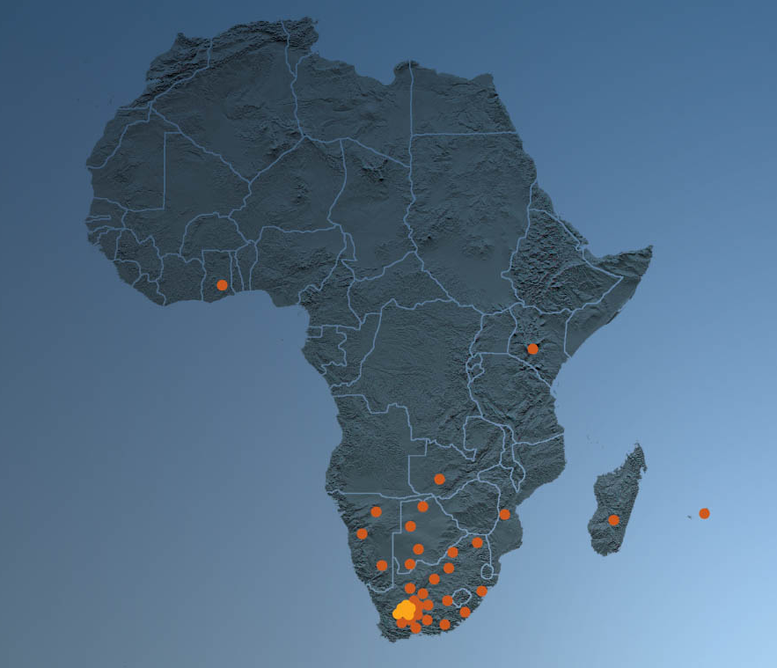
SKA Sites
SKA South Africa
SKA Australia / New Zealand

Slide 6
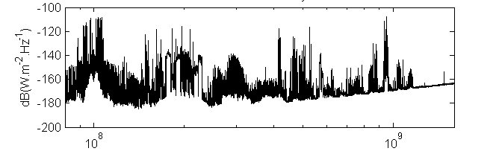
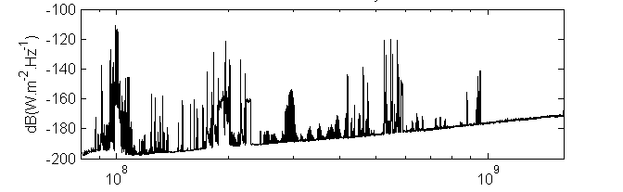
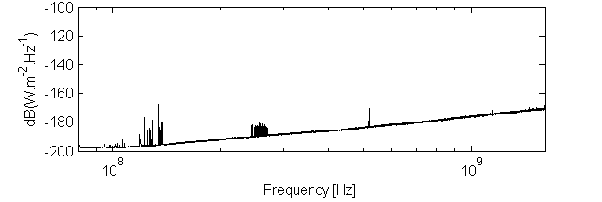
A Pristine Radio-Quiet Environment
CSIRO
Sydney
Pop. 4.8 million
Narrabri
(ATCA site)
Pop. 5,900
Murchison
Shire
(SKA1-Low site)
Pop. 114
Frequency (Hz)

Slide 7
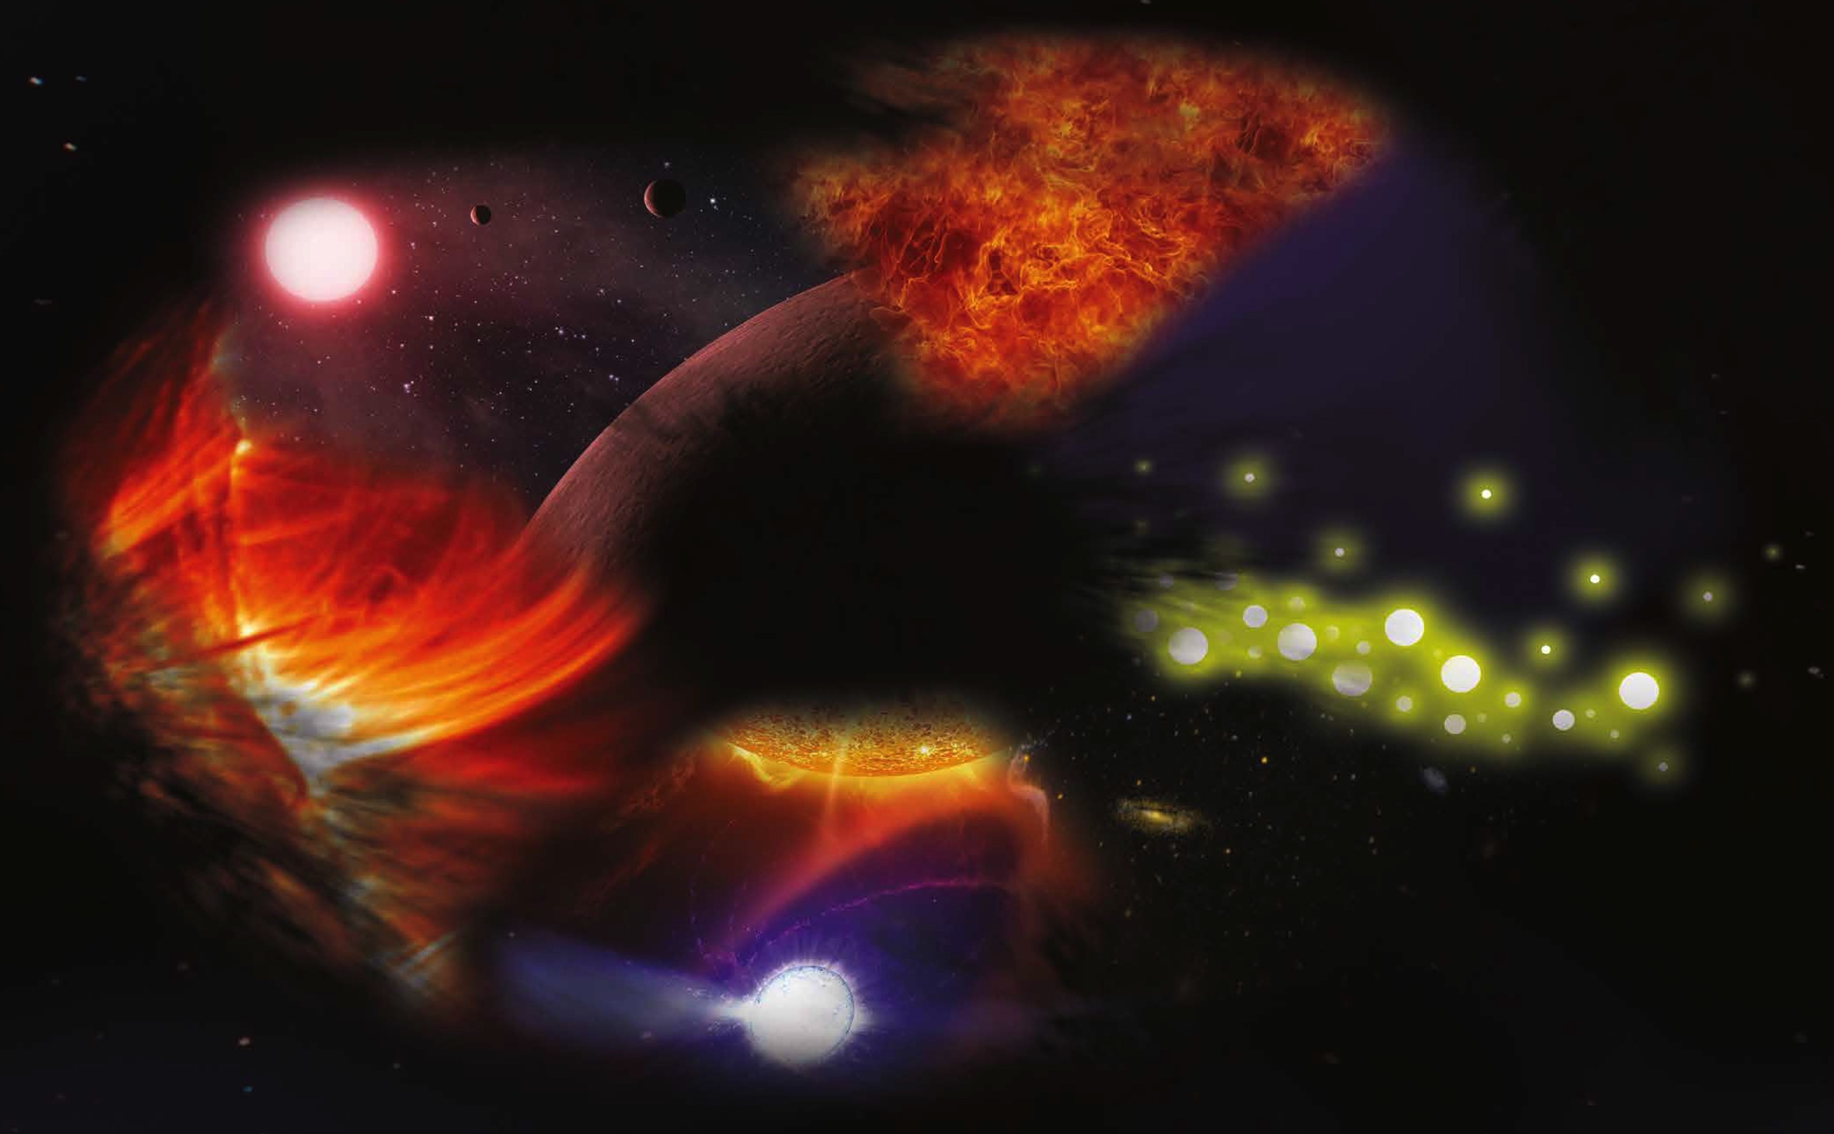
SKA Science
Fundamental Physics with Pulsars
Epoch of Reionisation
Cosmic Magnetism
Cosmology
The Transient Universe
The Continuum Universe
The Hydrogen Universe
The Cradle of Life & Astrobiology
SKA Organisation, Djorgovski et al., C. Reed NASA / JPL-Caltech / SSC, NASA / Stanford Lockheed-Martin Institute for Space Research’s TRACE team

Slide 8
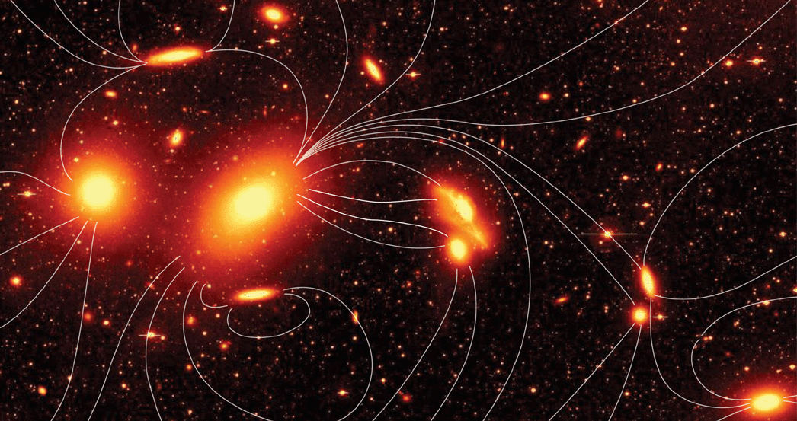
Cosmic Magnetism with the SKA
STRUCTURE
  What is the strength and structure of magnetic fields in the Milky Way, other galaxies, clusters, and the intergalactic medium?
EVOLUTION
  How have magnetic fields evolved in galaxies and clusters over cosmic time?
ORIGIN
  When and how was the Universe magnetised?
Mihos / Huey / Science
Notes:
Fix this

Slide 9
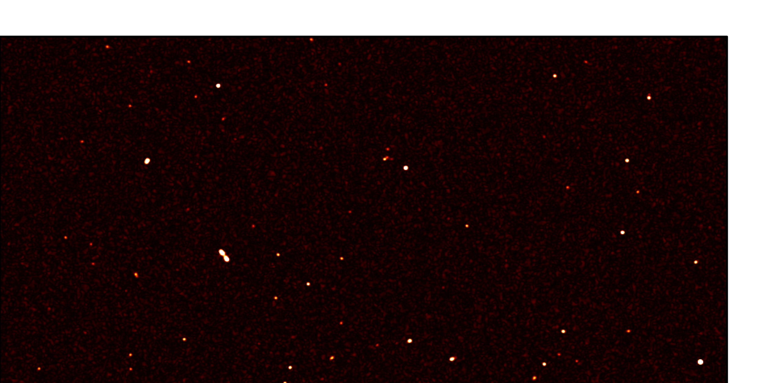

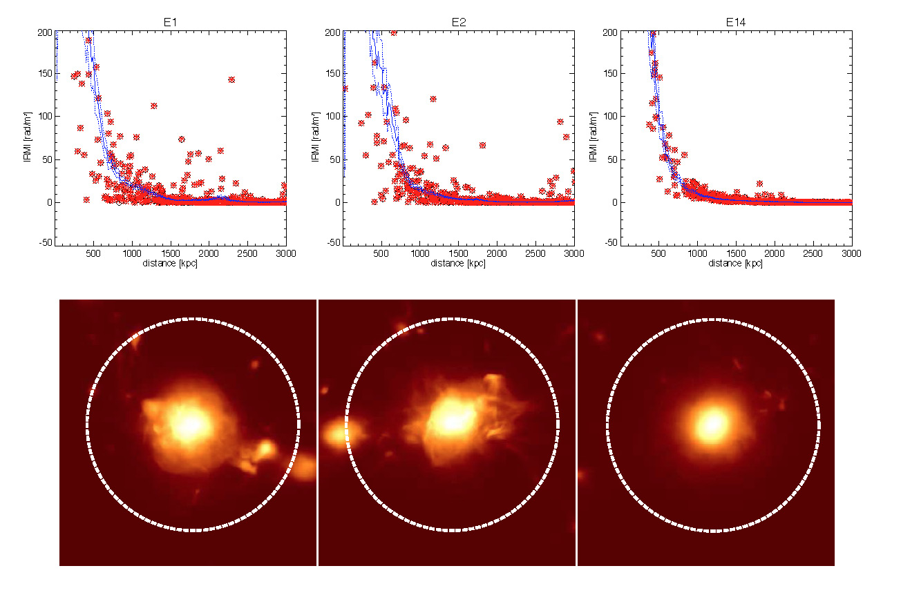
Structure: The Rotation Measure Grid
Polarisation surveys with
current telescopes:
  ~1 to 3 RMs per deg²
All-sky RMs with the SKA
(Johnston-Hollitt et al. 2015)
  SKA1: ~300 RMs per deg²
  SKA2: ~5000 RMs per deg²
Full 3D magnetic field of Milky Way, from large-scale field of disk/halo down to sub-parsec turbulence
(Sobey, Farrar, Oppermann, Jelić)
Reconstruction of magnetic field properties for thousands of galaxies, galaxy clusters, intergalactic medium
(Krause, Damas, Ferrière, Rudnick)
30 arcmin
Simulation of 5-min SKA observation (Anderson+ 2015)
Relaxed
Post-merger
Vazza et al. (2010), Bonafede et al. (2015)
RM (rad/m²)
distance (kpc)
distance (kpc)

Slide 10

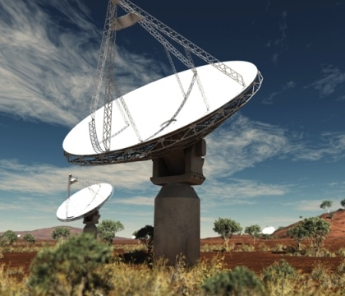

Structure: Pathfinders
Australian Square Kilometre Array Pathfinder
  36 12-m dishes, 30-deg² field of view
  early science observations beginning 2016
  Polarisation Sky Survey of the Universe’s Magnetism (POSSUM; askap.org/possum)
All-sky RM grid at density of ~30 RMs/deg²
Broadband polarisation (700-1800 MHz)
(Gaensler et al. 2015)
  information on intrinsic properties of
  background AGN (entrainment, outflows)
  Faraday thin vs thick: improve RM grid
  (Oppermann)
  “polarisation K-correction”: shift sources at
  different redshifts to common rest frame
CSIRO / Swinburne
ν = 1400 MHz, Δν = 350 MHz
ν = 1200 MHz, Δν = 1000 MHz
0.03 0.06 0.09 0.12 0.15 0.18 0.21
Thermal gas entrained with lobes
Simple source
Turbulent foreground absorber
(O’Sullivan et al. 2012)

Slide 11
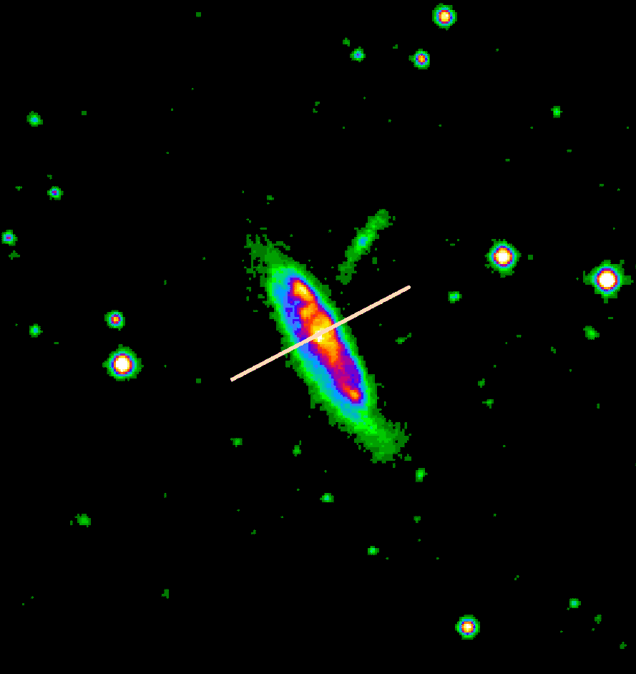
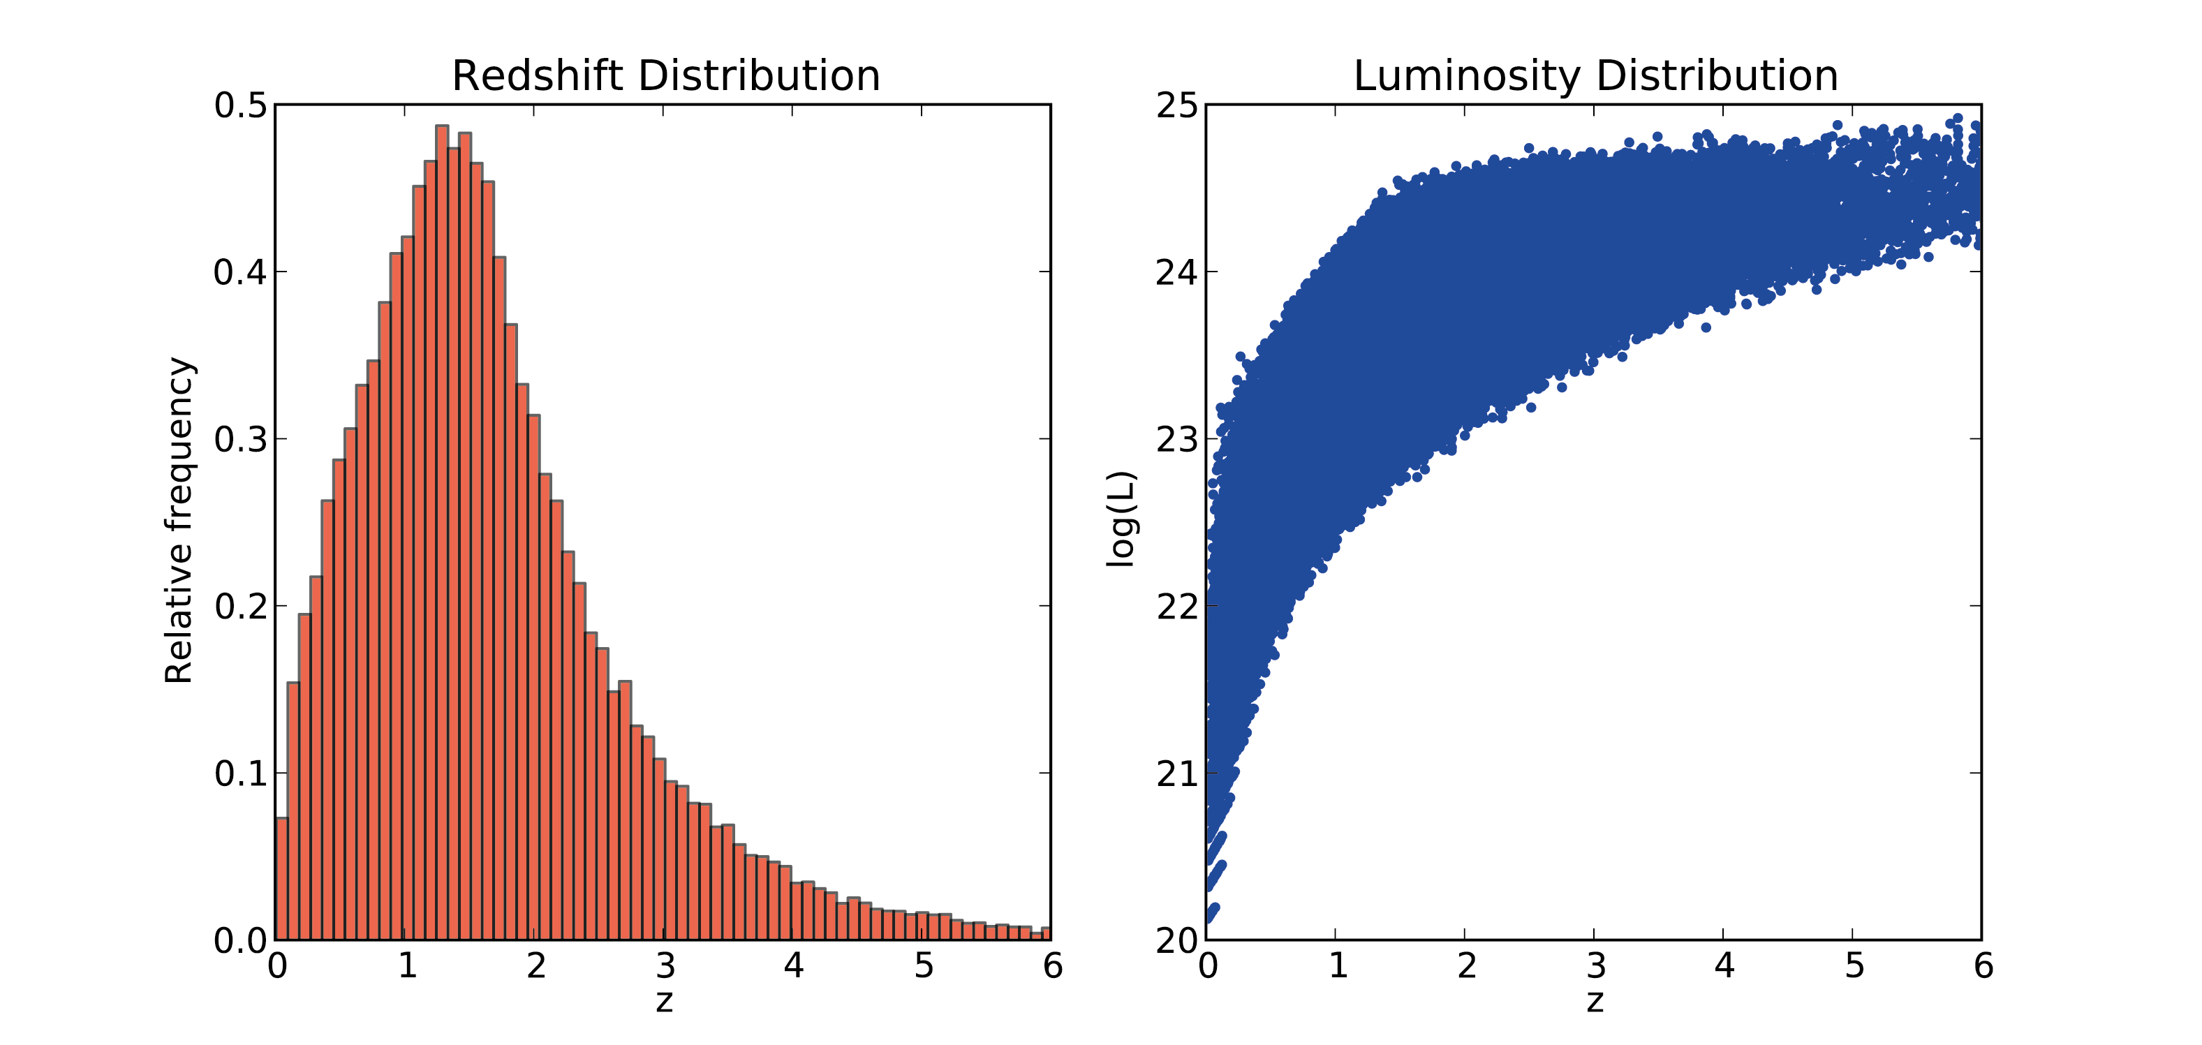
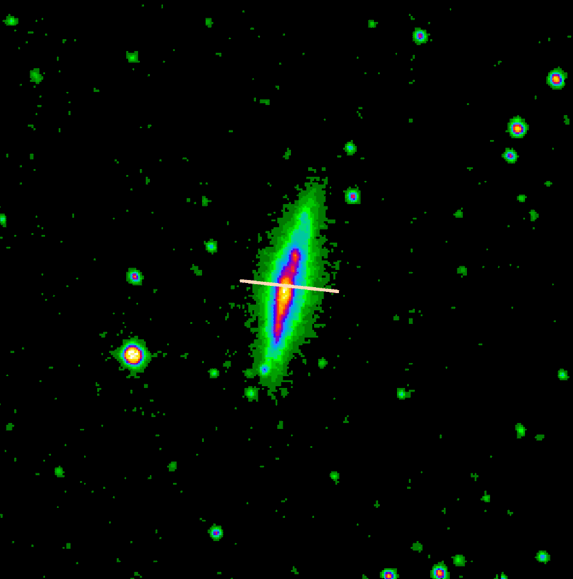
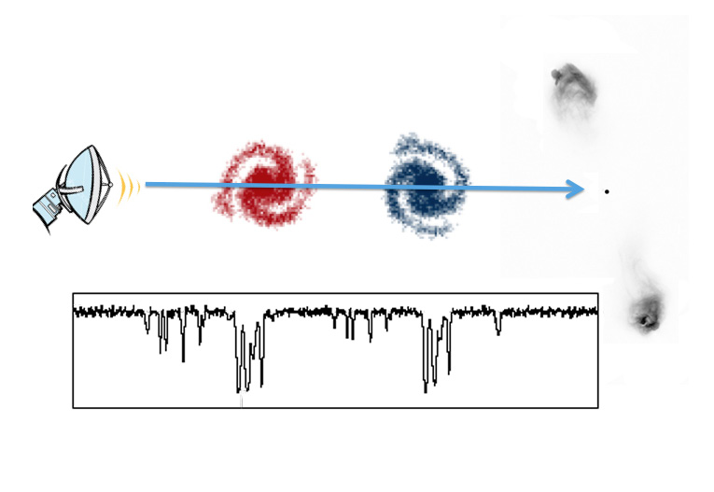
Evolution: Deep Polarisation Fields
Integrated polarisation of normal galaxies
reveals large-scale B orientation (Stil+ 2009)
(Krause, Damas, Chyzy)
Deep observations with SKA1: 50,000 normal
galaxies to redshift z > 4 (Taylor+ 2015)
  rate of field ordering and amplification,
  as function of redshift and galaxy mass
  role of feedback, interaction, outflows
  evolution in Faraday depth as gas is
  transformed into stars
Mg II absorption along the line of sight
(Farnes et al. 2014; Williams)
  evolution in coherent fields of
  intervening systems
Jeroen Stil
Jamie Farnes

Slide 12
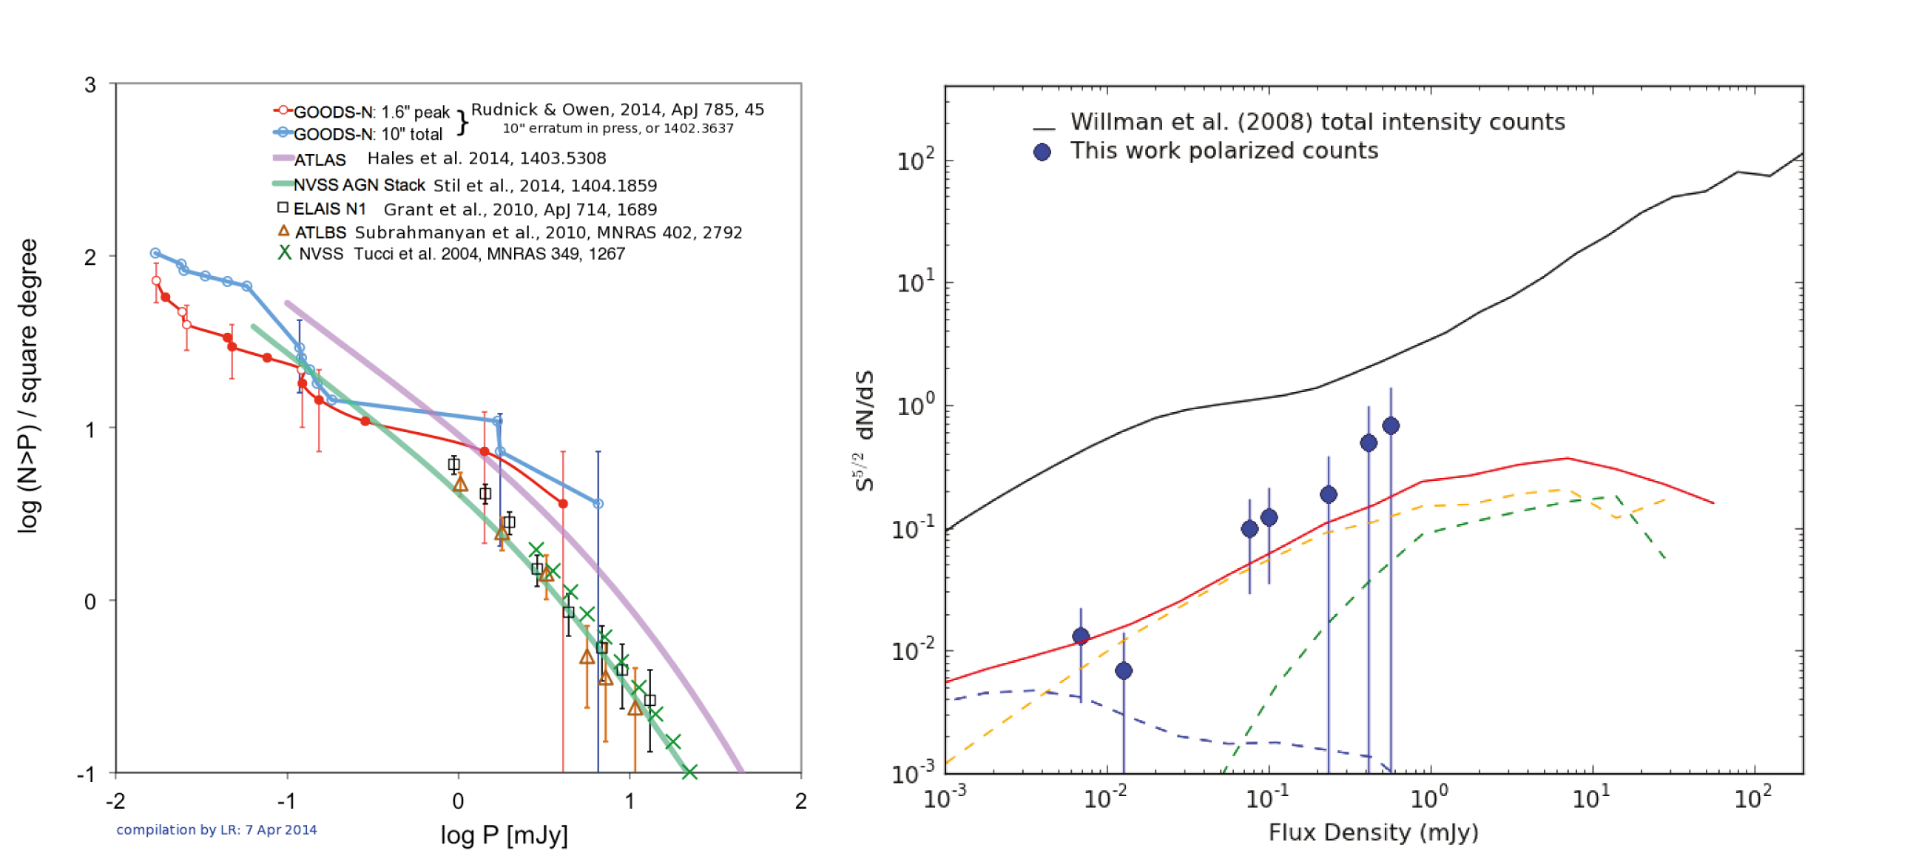
Evolution: Pathfinders
Deep polarisation fields with ATCA and VLA
(Hales et al. 2014ab; Rudnick & Owen 2014)
  flattening of source counts for P < 1 mJy ;
  emergence of star-forming population?
  crucial data for SKA forecasts, but limited
  field of view & small-number statistics
Deep fields: MeerKAT (MIGHTEE-pol), VLA (VDCS)
  multiple tiers: wide to 35 deg², deep to 0.1 μJy
  broad frequency coverage: 0.6 – 4 GHz
Cross-correlation of NVSS and SDSS
(Farnes, Gaensler et al. 2014)
  599 sources with RM, z, Mg II information
  201 sightlines with absorption, 398 without
  excess |RM| at 3.5σ: B ~ 2 μG at z ~ 0.9
log (N>P) / square degree
Larry Rudnick
log P (mJy)
N_{Mg} = 0
N_{Mg} = 1
N_{Mg} ≥ 2
fraction (> RM)
Farnes et al. (2014)
| RM | (rad m⁻²)

Slide 13
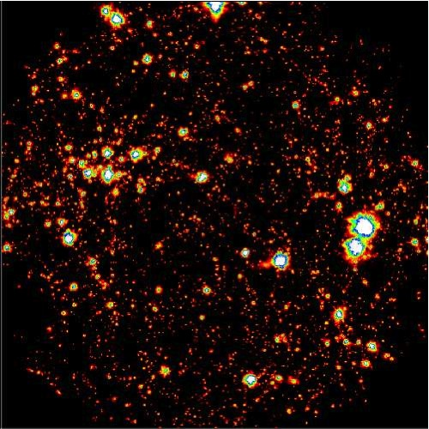
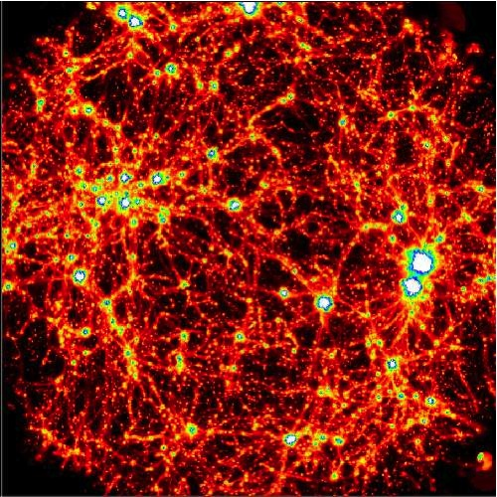
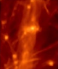
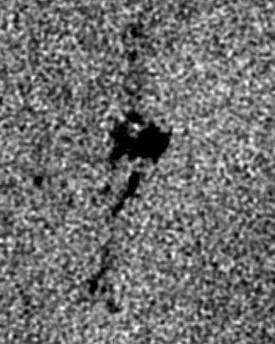
Origin: The Synchrotron Cosmic Web
Intergalactic shocks accelerate electrons and amplify magnetic fields
(Keshet et al. 2004; Hoeft & Brüggen 2007; Battaglia et al. 2009; Araya-Melo et al. 2012)
  faint synchrotron radiation should trace large-scale structure and cosmic filaments
  → direct image of large-scale structure of the Universe
  → laboratory for studying particle acceleration in low-density shocks
  → magnetic field strength of the intergalactic medium
  → direct discriminant on competing models for origin of cosmic magnetism
Signal should be detectable with SKA1-Low (scales ~ 10′ to 1º at ν ~ 100 MHz)
Large-scale B distribution for Injected vs primordial fields
(Donnert, Dolag et al. 2009)
Deep SKA1-Low observation of simulated filament
(Vazza et al. 2015)

Slide 14
Origin: Pathfinders
Murchison Widefield Array
  80-300 MHz, including FM band
  128 tiles over 3 km → ~1’ resolution
  first fully operational SKA precursor
  1000 deg² field of view
Search for cosmic web via cross-correlation of diffuse emission with large-scale structure
BBC Two Horizon
S-PASS survey at 2.3 GHz (Carretti et al. 2011)
MWA at 150 MHz (André Offringa)

Slide 15


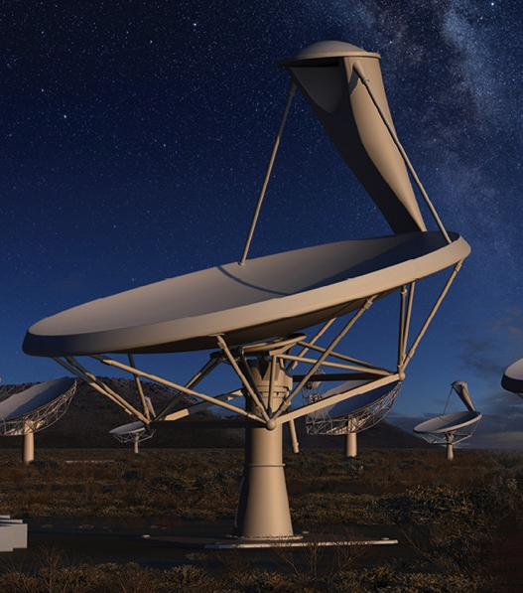
Conclusions
“Cosmic Magnetism” is a key science program
for the billion-dollar Square Kilometre Array
  join the SKA Magnetism Working Group:
  http://astronomers.skatelescope.org
Unique radio science
  Rotation measure grid: structure of B
  in Milky Way, galaxies, clusters and IGM
  Deep polarisation fields and Mg II absorbers:
  evolution of B in normal galaxies and
  in AGN over cosmic time
  Synchrotron cosmic web: direct imaging of intergalactic B, probes origin of cosmic magnetism
SKA precursors (ASKAP, MeerKAT, MWA) now
finally poised to begin revealing the polarised sky
2018- : Exploration of full Magnetic Universe with the Square Kilometre Array
SKA
SKA Organisation

Slide 17
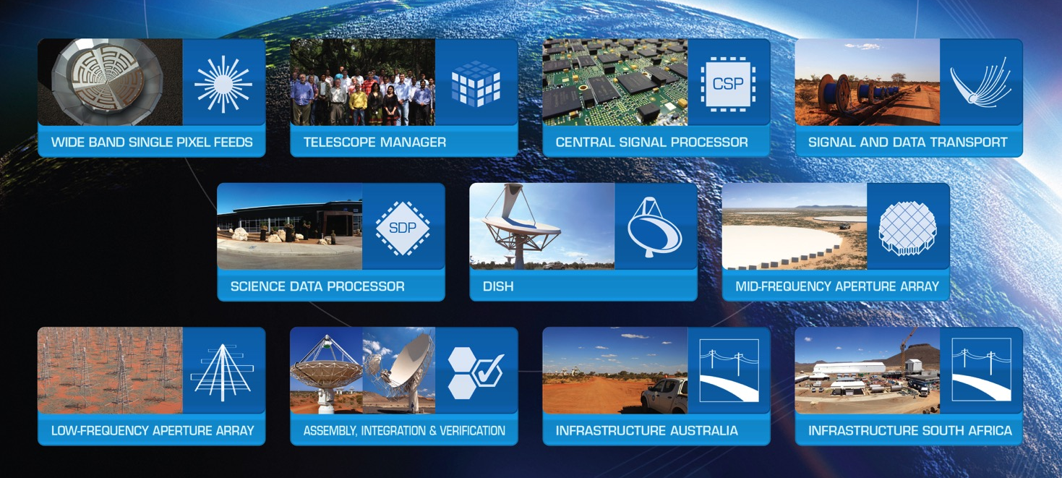
SKA Pre-construction
€150M global design effort
  ~500 scientists and engineers in 20 countries
SKA Organisation

